Slide 1
HAS AIRLINE DEREGULATION BEEN A NEOLIBERAL SUCCESS?
MARK S. KAHAN
ADJUNCT PROFESSORIAL LECTURER
DEPARTMENT OF GOVERNMENT
AMERICAN UNIVERSITY

Slide 2
WHY DO PROGRESSIVES HATE BILL CLINTON?
MARK S. KAHAN
ADJUNCT PROFESSORIAL LECTURER
DEPARTMENT OF GOVERNMENT
AMERICAN UNIVERSITY

Slide 3
KUTTNER ON NEOLIBERALISM
Beginning with the presidency of Jimmy Carter, a succession of Democratic presidents joined Republicans in turning away from the New Deal model of regulated capitalism toward what has come to be known as neoliberalism. The neoliberal credo claims that markets work efficiently and that government attempts to constrain them via regulation and public spending invariably fail, backfire, or are corrupted by politics. As public policy, neoliberalism has relied on deregulation, privatization, weakened trade unions, less progressive taxation, and new trade rules to reduce the capacity of national governments to manage capitalism. These shifts have resulted in widening inequality, diminished economic security, and reduced confidence in the ability of government to aid its citizens.
Robert Kuttner (NYR of Books, 7/21/22)

Slide 4
CLINTON WAS A BAD GUY? ME TOO?
“[N]eoliberalism is a coherent ideology and set of deliberate policies intended to destroy the New Deal legacy of managed capitalism. Nor can this critique be dismissed as just “a meme on the left.” This history and Clinton’s central part in it have been well documented by scholars and journalists with no ideological agenda… Bill Clinton had an uncanny ability to survive personally, despite policies that were disastrous for his party and the country. I once described Clinton as the Typhoid Mary of American politics. He stayed healthy; those around him got sick.
Robert Kuttner (NYR of Books, 9/22/22)

Slide 5
SOME RECENT WORKS ON NEO-LIBERALISM
WENDY BROWN, UNDOING THE DEMOS: Neoliberalism’s Stealth Revolution (2015)
QUINN SLOBODIAN, GLOBALISTS: The End of Empire and the Birth of Neoliberalism (2018)
BINYAMIN APPLEBAUM, THE ECONOMISTS’ HOUR: False Prophets, Free markets, and the Fracture of Society (2019)
SHOSHANA ZUBOFF, THE AGE OF SURVEILLANCE CAPITALISM: The Fight for a Human Future At the New Frontier of Power (2019)
GARY GERSTLE, THE RISE AND FALL OF THE NEOLIBERAL ORDER: America and the World in the Free Market Era (2022)

Slide 6
COHERENT IDEOLOGY? PART ONE
"A fascinating study by University of California law professor Jodi Short empirically illustrates the role of neoliberal ideology as one important explanation of Google’s ambitions… Short analyzed 1400 law review articles on the subject of regulation, all published between 1980 and 2005. As the influence of Hayek and Friedman predicts, the dominant theme of this literature was "the coercive nature of administrative government" and the systematic conflation of industry regulation with "tyranny" and "authoritarianism." According to this world view, all regulation is burdensome, and bureaucracy must be repudiated as a form of human domination.“
Shoshana Zuboff, The Age of Surveillance Capitalism 107

Slide 7
COHERENT IDEOLOGY? PART 2
"Neoliberalism … is a loose and shifting signifier. It is a scholarly commonplace that neoliberalism has no fixed or settled coordinates, that there is temporal and geographical variety in its discursive formulations, policy entanglements, and material practices… Neoliberalism as economic policy, a modality of governance, and an order of reason is at once a global phenomenon, yet inconstant, differentiated, unsystematic, impure… It names a historically specific economic and political reaction against Keynesianism and democratic socialism…
"It is a commonplace today that market values are crowding out all others and that vulnerable, precious, or sacred things, including democracy itself, are being increasingly and inappropriately subject to markets.”
Wendy Brown, Undoing the Demos: Neoliberalism's Stealth Revolution 20-21,79

Slide 8
BROWN’S SPECIFICS 28-29
SUSPECT POLICIES
DEREGULATION OF INDUSTRIES
PRIVITIZATION OF PUBLIC GOODS
INCREASED REGRESSIVE TAXATION
END OF WEALTH DISTRIBUTION
MONITIZING EVERY HUMAN NEED
FINANCIALIZATRION OF EVERYTHING
SUSPECT EFFECTS
INTENSIFIED INEQUALITY
CRASS/UNETHICAL COMMERCIALIZATION
EVER-GROWING INTAMCY BETWEEN CORPORATE/FINANCE CAPITAL AND STATE
ECONOMIC HAVOC FROM FINANCIAL BUBBLES AND FLUCTUATIONS
EXTENDING ECONOMIC VALUES, PRACTICES, METRICS TO EVERY DIMENSION OF HUMAN LIFE

Slide 9
THE CRITICS’ STORY ABOUT NEOLIBERALISM AND REGULATION FROM ROOSEVELT TO BIDEN
FDR JETTISONS LAISSEZ-FAIRE APPROACH AND ADOPTS KEYNESIAN MANAGEMENT OF THE ECONOMY TO MANAGE CAPITALISM
EISENHOWER ACCEPTS THE BASIC FRAMEWORK
JOHNSON GREAT SOCIETY DOUBLES DOWN
NIXON PRESSED BY REFORMERS IS EVEN MORE REGULATORY
CARTER BEGINS DEREGULATION AND AUSTERITY UNDER INFLATION PRESSURES
REAGAN GOES BEYOND DEREGULATION, DESCRIBING GOVERNMENT AS ENEMY
CLINTON ADOPTS REAGAN’S APPROACH, DEIFYING MARKETS
IT JUST KEEPS ON GETTING WORSE FOR PROGRESSIVES

Slide 10
CLINTON E.O. 12866 (October 4, 1993)
Section 1. Statement of Regulatory Philosophy and Principles.
The Regulatory Philosophy. Federal agencies should promulgate only such regulations as are required by law, are necessary to interpret the law, or are made necessary by compelling public need, such as material failures of private markets to protect or improve the health and safety of the public, the environment, or the well-being of the American people. In deciding whether and how to regulate, agencies should assess all costs and benefits of available regulatory alternatives, including the alternative of not regulating.
compelling: not able to be refuted; inspiring conviction.
material: important; essential; relevant

Slide 11
HOW DO MARKETS FAIL/WHY REGULATE?
Externalities
Public Goods and Common Resources
Market Power
Inadequate or Asymmetric Information
Other Social Purposes?
From OMB Circular A-4 (September 17,2003)
DOES THE PRICE SYSTEM WORK?
Notes:
EXTERNALITIES -- OCCUR WHEN ANY ONE PARTY’S ACTIONS IMPOSE UNCOMPENSATED BENEFITS OR COSTS ON ANOTHER PARTY
PUBLIC GOODS -- ARE GOODS WHERE THE PROVISION OF THE GOOD TO SOME INDIVIDUALS CANNOT OCCUR W/O PROVISION OF THE SAME GOODS TO OTHERS FREE OF CHARGE. EXAMPLE --- DEFENSE OR BASIC SCIENTIFIC RESEARCH
COMMON RESOURCES – RESOURCES SUBJECT TO CONGESTION OR OVERUSE, SUCH AS FISHERIES, THE BROADCAST SPECTRUM, OR AIRPORTS
MARKET POWER – WHEN A FIRM HAS THE ABILITY TO REDUCE OUTPUT BELOW WHAT A COMPETITIVE MARKET WOULD PRODUCE AND THEREBY RAISE PRICES
ASSYMETRIC INFO –WHEN BUYER AND SELLER HAVE DISPROPORTIONATE ACCESS TO RELEVANT INFORMATION

Slide 12
WHY REGULATE AIRLINES?
Externalities: Safety and Environmental (noise, emissions)
Public Goods and Common Resources: Airports and Airways
Market Power: Prices and Services
Inadequate or Asymmetric Information: Safety and Deceptive Marketing
Other Social Purposes: Essential Air Services

Slide 13
Why Deregulate Airlines?
Market Power is limited because competition is possible
Market Power is limited because economies of scale and scope (networks) are not inexhaustible
“Destructive competition” is unlikely because managements do not have a death wish
The agency (CAB) is a corrupt (Watergate), captured institution
Texas (Southwest) and California (Pacific Southwest) have shown that unregulated intrastate airlines price lower than CAB regulated carriers
Washington bureaucrats have no clue what consumers want
Is Neoliberalism or ideology in general a factor?

Slide 14
KAHN ON HOW AIRLINE DEREGULATION EMERGED AGAINST INDUSTRY OPPOSITION
“First you had the ubiquitous problem of inflation. It was primarily a monetary problem, but it was not hard to persuade — well it was hard, but by demonstration you could show that the introduction of competition in industries where competition had been systematically repressed by government produced reduced prices.
Then you had this convergence intellectually of enlightened conservatives and liberals led by Ted Kennedy. The Ford administration had already decided it was for deregulation, but it was never going to succeed on its own because it was a conservative administration. It took a combination of the conservatives and 20th century liberals (which is what I am), advocates of competition, and the convergence of inflation.
In the airline case, we had something very persuasive. Load factors for the decade before 1976 were 51.3 percent on average. The planes were half full. We also had evidence from intrastate airlines [not subject to CAB regulation], which operated at higher load factors and lower fares.”

Slide 15
Was Airline Deregulation a Success?
Prices
Services
Diversity of choices
Service quality: Frequency, Hubs, comfort
Employees
Distribution of Income

Slide 16
DEREGULATED VS. REGULATED AIR FARES
 | Fare per Mile ($) % of Adj. SIFL^
Combination* Airline | B | B+CO | B+CO +1 | B+CO +2
United Airlines | (30%) | (22%) | (11%) | 2%
Delta Air Lines | (28%) | (28%) | (18%) | (4%)
American Airlines | (30%) | (30%) | (21%) | (8%)
Alaska Airlines | (30%) | (30%) | (20%) | (7%)
Southwest Airlines | (37%) | (37%) | (37%) | (37%)
JetBlue Airways | (36%) | (36%) | (27%) | (14%)
Frontier Airlines | (52%) | (38%) | (29%) | (19%)
Spirit Airlines | (45%) | (35%) | (27%) | (15%)
Total Average | (33%) | (30%) | (22%) | (11%)
Total Average for Query | (24%)
TABLE 2.1.1. Stage-length adjusted price per mile for each combination of bags averaged across all queries by individual airlines as a percentage of Adjusted SIFL^
^ SIFL calculation adjusted to include mandatory taxes, including excise tax, TSA Security Fees, and Passenger Facility Charges, which were also included in all website fare data.

Slide 17
AIRLINE LEISURE DEAL RANKINGS
 | Fare per Mile ($) |  |  |  | Rank
Combination* Airline | B | B+CO | B+CO +1 | B+CO +2 | B | B+CO | B+CO +1 | B+CO +2
United Airlines | 0.175 | 0.198 | 0.226 | 0.263 | 7 | 8 | 8 | 8
Delta Air Lines | 0.153 | 0.153 | 0.182 | 0.221 | 3 | 2 | 2 | 5
American Airlines | 0.165 | 0.165 | 0.188 | 0.220 | 6 | 4 | 4 | 4
Alaska Airlines | 0.140 | 0.140 | 0.166 | 0.202 | 1 | 1 | 1 | 2
Southwest Airlines | 0.191 | 0.191 | 0.191 | 0.191 | 8 | 7 | 5 | 1
JetBlue Airways | 0.161 | 0.161 | 0.185 | 0.218 | 5 | 3 | 3 | 3
Frontier Airlines | 0.148 | 0.185 | 0.209 | 0.238 | 2 | 6 | 7 | 6
Spirit Airlines | 0.155 | 0.184 | 0.209 | 0.242 | 4 | 5 | 6 | 7
Total Average | 0.166 | 0.173 | 0.194 | 0.222
Total Average for Query | 0.172
TABLE 1.2.4. Stage-length adjusted price per mile for each combination of bags in Leisure Query by individual airlines and their associated rank within each bag combination

Slide 18
AIRLINE BUSINESS DEAL RANKINGS
 | Fare per Mile ($) |  |  |  | Rank
Combination* Airline | B | B+CO | B+CO +1 | B+CO +2 | B | B+CO | B+CO +1 | B+CO +2
United Airlines | 0.243 | 0.266 | 0.293 | 0.330 | 5 | 6 | 6 | 6
Delta Air Lines | 0.280 | 0.280 | 0.307 | 0.343 | 8 | 8 | 8 | 8
American Airlines | 0.251 | 0.251 | 0.278 | 0.315 | 6 | 5 | 5 | 5
Alaska Airlines | 0.273 | 0.273 | 0.300 | 0.335 | 7 | 7 | 7 | 7
Southwest Airlines | 0.214 | 0.214 | 0.214 | 0.214 | 4 | 4 | 2 | 1
JetBlue Airways | 0.200 | 0.200 | 0.225 | 0.258 | 3 | 2 | 4 | 4
Frontier Airlines | 0.128 | 0.165 | 0.189 | 0.218 | 1 | 1 | 1 | 2
Spirit Airlines | 0.174 | 0.201 | 0.223 | 0.254 | 2 | 3 | 3 | 3
Total Average | 0.237 | 0.245 | 0.269 | 0.301
Total Average for Query | 0.172
TABLE 1.2.2. Stage-length adjusted price per mile for each combination of bags in Business Query by individual airlines and their associated rank within each bag combination

Slide 19
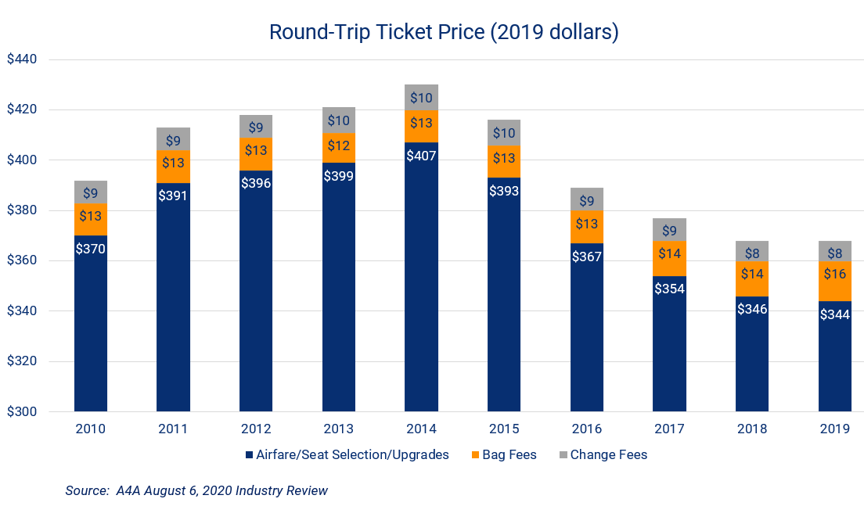
ROUND TRIP TICKET PRICE

Slide 20
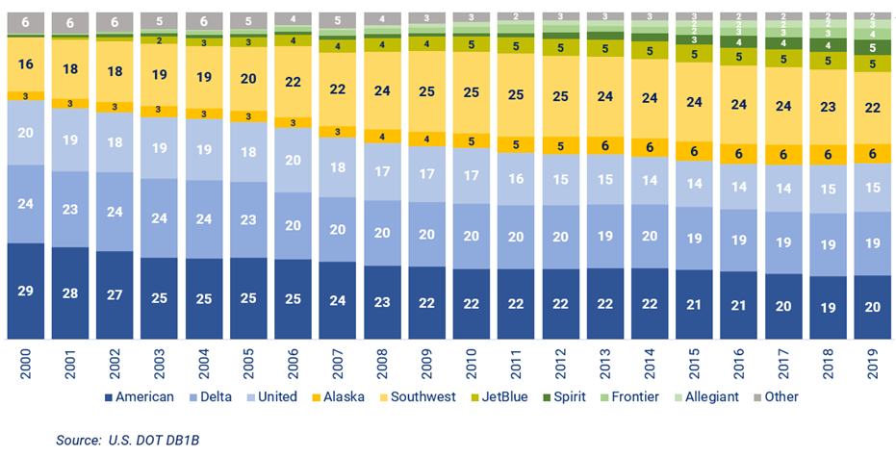
U.S. DOMESTIC O&D MARKET SHARE

Slide 21
MEASURING INDUSTRY CONCENTRATION
WHAT IS THE RELEVANT MARKET?
HERSCHMAN-HERFINDAL INDEX (HHI)
The sum of the squared shares of each market participant.
Thus, a 100% monopoly has an HHI of 10,000
A totally atomized market (e.g., a hundred participants each with a 1% share) would have an HHI of 100.
WHEN IS AN INCREASE IN HHI POTENTIALLY HARMFUL?
Unconcentrated Markets: HHI below 1500 • Moderately Concentrated Markets: HHI between 1500 and 2500 • Highly Concentrated Markets: HHI above 2500
Small Change in Concentration: Increase in the HHI of less than 100 points, NFA • Unconcentrated Markets: NFA • Moderate Concentration, increase in the HHI more than 100 points potentially raises significant concerns • Highly Concentrated Markets: Increase in the HHI of between 100 points and 200 points potentially raise significant competitive concerns; an increase more than 200 points will be presumed to enhance market power.

Slide 22
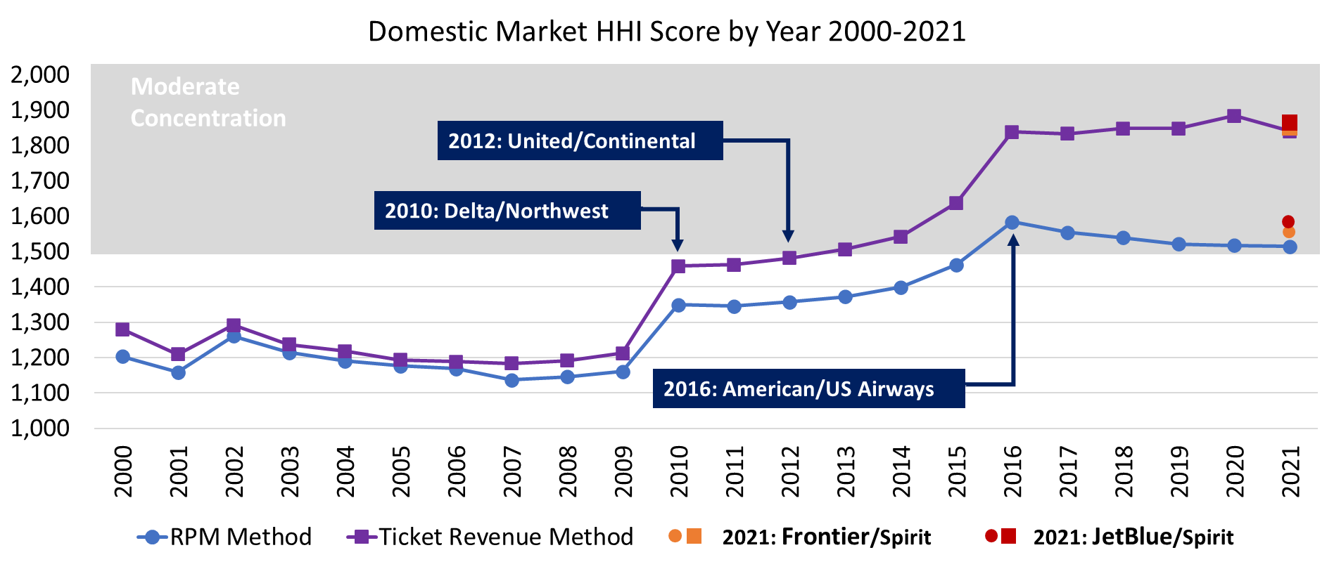
CARRIERS PER O&D MARKET

Slide 23
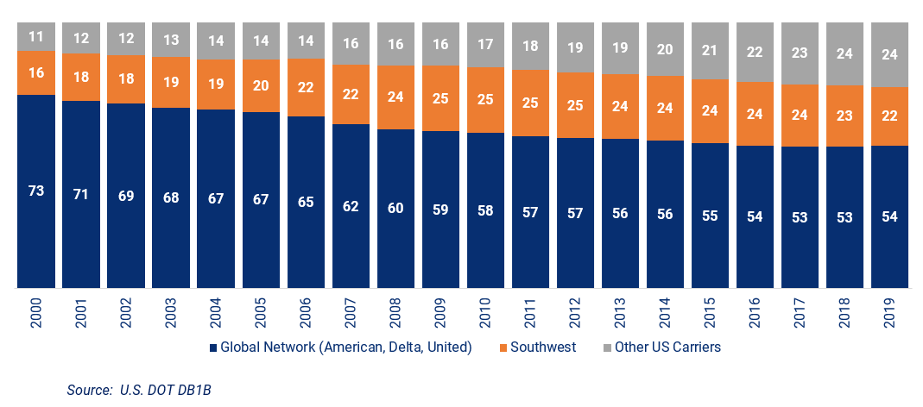
MARKET SHARE BY BUSINESS MODEL

Slide 24
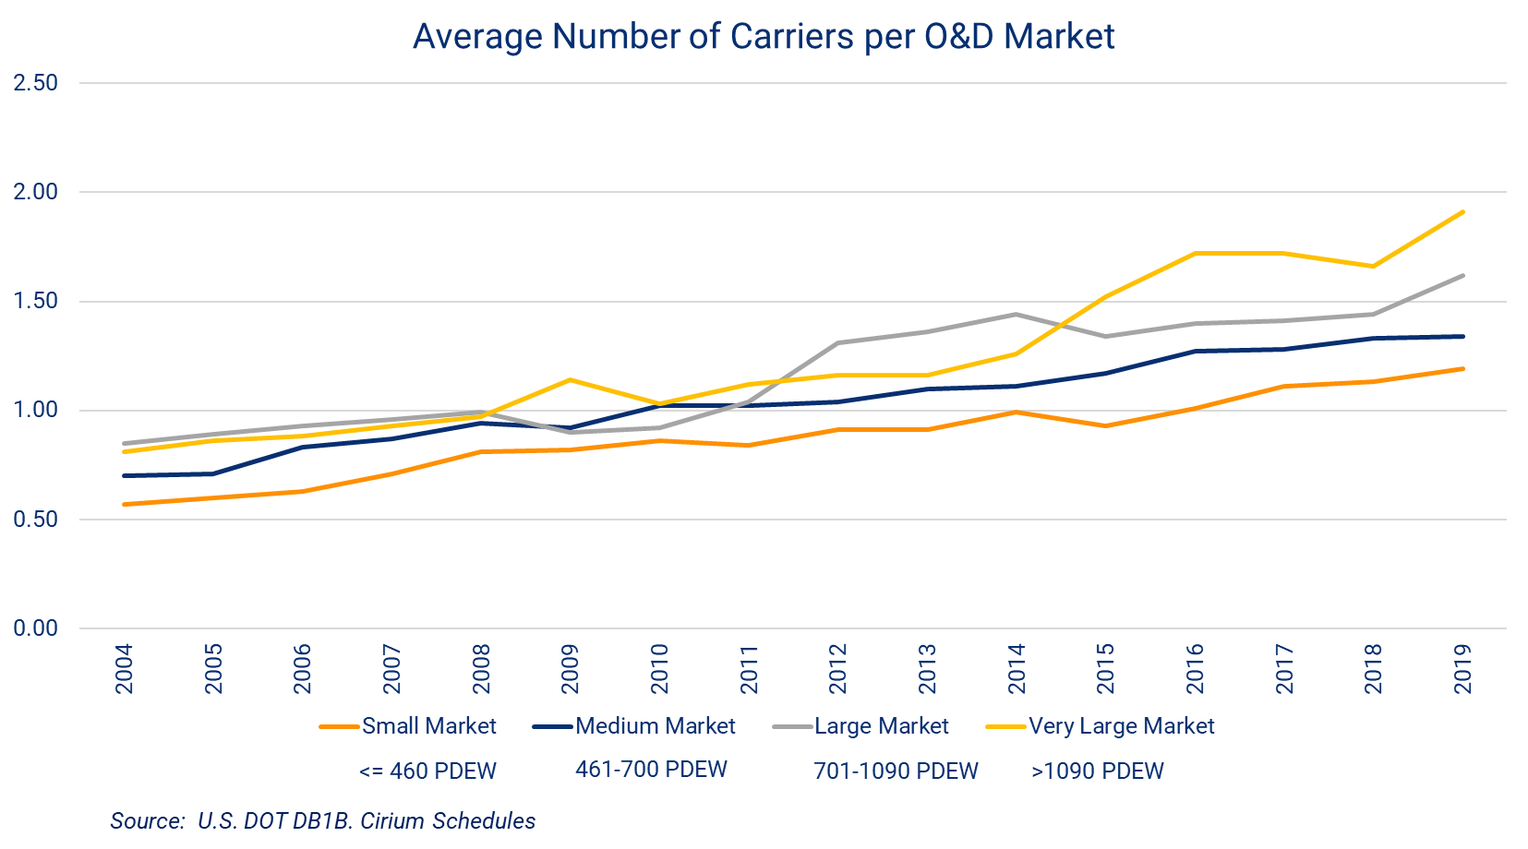
CARRIERS PER O&D MARKET

Slide 25
CLINTON REGULATORY RECORD ON AIRLINE DEREGULATION
FARES REACH HIGHEST LEVELS IN 1996-2000 AS PROSPERITY CREATES FAVORABLE SUPPLY-DEMAND BALANCE
INCREASES NEW ENTRY FITNESS REGULATION POST-VALUJET CRASH
RESPONDS TO NEW ENTRANT (LLC) PREDATORY PRICING COMPLAINTS VIA PROPOSED COMPETITION GUIDELINES, NEVER FINALIZES
WORKS WITH McCAIN TO RELAX HIGH DENSITY RULE, FLEES FROM CHAOS
WATCHES FARES COLLAPSE IN 2000

Slide 26
WHY REGULATE FINANCIAL INSTITUTIONS?
EXTERNALITIES: SYSTEMIC RISK/DEPOSIT INSURANCE/CREDIT RATING AGENCIES
PUBLIC GOODS AND COMMON RESOURCES: FEDERAL RESERVE SYSTEM AS LENDER OF LAST RESORT/DEPOSIT INSURANCE/ FANNIE & FREDDIE
MARKET POWER: INTERSTATE BANKING, S&L DEVOLUTION, AND BANK CONSOLIDATION
ASSYMETRIC INFORMATION: COLLATERALIZED DEBT OBLIGATIONS, CREDIT DEFAULT SWAPS, CONSUMER “DISCLOSURE,” PREDATORY LENDING
NEOLIBERALISM OR LAX/INEPT REGULATION ?

Slide 27
CLINTON RECORD ON FINANCIAL REGULATION
1994 RIEGLE-NEAL ELIMINATES RESTRICTIONS ON INTERSTATE BANKING
1994 HOME OWNERSHIP AND EQUITY PROTECTION ACT (HOEPA)-
STRENGTHENS PROTECTIONS AGAINST PREDATORY LENDING
ENFORCEMENT UNDERMINED BY GREENSPAN INTERPRETATION
1999 GRAMM-LEACH-BLILEY
PERMITS BANKS TO OWN “INCIDENTAL” OR “COMPLEMENTARY” NON-FINACIAL ASSETS
ELIMINATES GLASS-STEAGALL REMOVING WALL BETWEEEN COMMERCIAL AND INVESTMENT BANKING
2000 COMMODITY FUTURES MODERNIZATION ACT PERMITS UNREGULATED OVER-THE-COUNTER DERIVATIVES CONTRACTS
2000 - REAPPOINTMENT OF GREENSPAN

Slide 28
ENERGY AND CLIMATE CHANGE
EXTERNALITIES: ENVIRONMENTAL POLLUTION AND GLOBAL WARMING
PUBLIC GOODS AND COMMON RESOURCES: ENVIRONMENTAL POLLUTION AND INFRASTRUCTURE
MARKET POWER: GLOBAL CARTEL/CONSOLIDATION IN FOSSIL FUEL INDUSTRY
ASSYMETRIC INFORMATION: FAILURE OF NUCLEAR LICENSING (REACTORS AND WASTE)/FRACKING TECHNOLOGY/
OTHER SOCIAL PURPOSES: NEPA AND ITS REFORM
CAN CIRCULAR A-4 ANALYSIS EXPLAIN WHY WE FLAIL? ARE PUTIN AND MBS NEOLIBERALS?

Slide 29
CLINTON RECORD ON CLIMATE CHANGE
BTU TAX GOES DOWN IN FLAMES-1993
1993 CLIMATE CHANGE TECHNOLOGY INITIATIVE
1994 ELECTIONS AND CONTRACT WITH AMERICA
REGIONAL TRANSMISSION ORGANIZATIONS (RTOs) FACILITATE INTERSTATE WHOLESALE ELECTRICITY TRANSACTIONS – 1996-2000
2000 VETO TO OPEN YUCCA MOUNTAIN
METHANE – 1996 LANDFILL REGULATIONS, NO OTHER PROGRESS
1998 KYOTO PROTOCOL
DOMESTIC AND INTERNATIONAL STAKEHOLDER COLLISION
QUESTIONABLE ENFORCEMENT MECHANISMS
NOT RATIFIED BY SENATE
GREENHOUSE GAS EMISSIONS KEEP RISING

Slide 30
CLINTON RECORD AT FDA
KEEPS DAVID KESSLER AS COMMISSIONER, ENDS LIGHTER TOUCH REAGAN/BUSH APPROACHES
BACKS FDA ASSAULT ON TOBACCO
FIGHTS OFF GOP ABORTION POLITICS
APPROVES MORNING AFTER PILL IN 1998
APPROVES RU-486 BEFORE 2000 ELECTION
IMPLEMENTS 1992 PRESCRIPTION FEE USER DRUG ACT

Slide 31
Modernizing Regulatory Review
“identify ways to modernize and improve the regulatory review process, including through revisions to OMB’s Circular A-4, Regulatory Analysis, 68 Fed. Reg. 58,366 (Oct. 9, 2003), to ensure that the review process promotes policies that reflect new developments in scientific and economic understanding, fully accounts for regulatory benefits that are difficult or impossible to quantify, and does not have harmful anti-regulatory or deregulatory effects.”
“propose procedures that take into account the distributional consequences of regulations, including as part of any quantitative or qualitative analysis of the costs and benefits of regulations, to ensure that regulatory initiatives appropriately benefit and do not inappropriately burden disadvantaged, vulnerable, or marginalized communities.”
Letter of Joseph R. Biden (January 20, 2021)

Slide 32
THE END OF IDEOLOGY (BELL, 1960) 405
"The end of ideology is not – should not be – the end of utopia as well. If anything, one can begin the new the discussion of utopia only by being aware of the trap of ideology. The point is that ideologists are "terrible simplifiers." Ideology makes it unnecessary for people to confront individual issues on their individual merits. One simply turns to the ideological vending machine, and out comes the prepared formulae. And when these beliefs are suffused by apocalyptic fervor, ideas become weapons, and with a dreadful results."

Slide 33
BELL, THE END OF IDEOLOGY (1960) 21-22, ON AMERICA AS A MASS SOCIETY
"The revolutions in transport and communications have brought men into closer contact with each other and bound them in new ways. Tremors in one part of society affect all others. Despite this greater interdependence, however, individuals have grown more estranged from one another. The old primary group ties of family and local community have been shattered; ancient parochial faiths are questioned; few unifying values have taken their place. Most important, the critical standards of an educated elite no longer shape opinion or taste. As a result, mores and morals are in constant flux, relations between individuals are tangential or compartmentalized, rather than organic. At the same time, greater mobility, spatial and social, intensifies concerns over status… There ensues a search for new faiths. The stage is thus set for the charismatic leader, the secular Messiah, who, by bestowing upon each person the semblance of necessary grace and all fullness of personality, supplies a substitute for the older unifying belief that the mass society has destroyed.”

Slide 34
UNLIKELY COUPLE

Slide 35
IDEOLOGY/PRICES/MARKETS
Von Hayek: By ignoring market prices, [government regulation/socialism] deprives individuals of their unique contribution to society -- to express through their willingness to pay a price, their opinion of the worth of a [good or] service…Competition [is] superior not only because it is in most circumstances the most efficient method known but even more because it is the only method by which our activities can be adjusted to each other without coercive or arbitrary intervention of authority. (Road to Serfdom (1944, 1994 ed. 44))
Keynes: It is obvious that an [individualist society/market economy] left to itself does not work well or even tolerably...Capitalism, wisely managed, can probably be made more efficient for attaining economic ends than any system in sight but itself in many ways extremely objectionable. Our problem is to work out a social organisation which shall be as efficient as possible without offending our notions of a satisfactory way of life. (End of Laissez Faire (1926), pen. p.)
Notes:
HERE ARE TWO GREAT THINKERS WHO ARE LIKELY TO DIFFER ON MOST OF THE THINGS WE WILL DISCUSS THIS TERM
WHERE DO THEY AGREE? BOTH LIKE MARKETS.
WHERE DO THEY DISAGREE? KEYNES IS NOT AN ABSOLUTIST. “WISELY MANAGED…PROBABLY” ARE THESE GOOD QUALIFIERS OR ARE THEY WEASLE WORDS?
BY THE WAY, WHAT’S THE GOAL OF AN ECONOMY?
CREATE GOODS AND SERVICES? CREATE WEALTH? FOSTER SOCIAL HARMONY?
WHAT’S THE GOAL OF A GOOD REGULATION? FAIRNESS? EFFICIENCY?

Slide 36
WOULD EITHER KEYNES OR HAYEK REJECT E.O 12866/OMB CIRCULAR A-4?
HAYEK: It is important not to confuse opposition against [socialism/collectivism] with a dogmatic laissez-faire attitude. The liberal argument is in favor of making the best possible use of the forces of competition as a means of coordinating human efforts, not an argument for leaving things just as they are… It does not deny, but even emphasizes, that, in order that competition should work beneficially, a carefully thought-out legal framework is required and that neither the existing nor the past legal rules are free from grave defects. Nor does it deny that, where it is impossible to create the conditions necessary to make competition effective, we must resort to other methods of guiding economic activity.… An effective competitive system needs and intelligently designed and continuously adjusted legal framework as much as any other. Even the most essential prerequisite of its proper functioning, the prevention of fraud and deception (including exploitation of ignorance), provides a great and by no means yet fully accomplished object of legislative activity

Slide 37
KEYNES TO FDR, LETTER FEB. 1. 1938 DURING THE 2ND DEPRESSION
CURB YOUR RHETORIC AGAINST BUSINESSPEOPLE.
THEY “ARE PERPLEXED, BEMUSED, INDEED TERRIFIED…IF YOU WORK THEM INTO THE SURLY,OBSTINATE, TERRIFIED MOOD…THE NATIONS BURDENS WILL NOT GET CARRIED TO MARKET”

Slide 38
TODAY’S AGENDA
DEFINE REGULATION AND DEREGULATION AND EXPLORE NEO-LIBERALISM
DIFFERENT VARIETIES OF REGULATION
DOES NEOLIBERALISM EXIST?
IF SO, WHAT IS IT?
EXPLORE AIRLINE DEREGULATION
WHAT FORCES ANIMATED IT?
WHAT KIND OF PEOPLE BACKED IT?
HAS SOCIETY BENEFITED?
IS THE JETBLUE-SPIRIT MERGER A GOOD THING?
IS AIRLINE DEREGULATION PART OF THE NEO-LIBERAL “Project?
CLIMATE CHANGE, FINANCIAL CRISIS, SMOKING, ETC.
DOES THE IDEA OF NEO-LIBERALISM ADD TO PUBLIC POLICY ANALYSIS?

Slide 39
Less Unlikely Couple

Slide 40
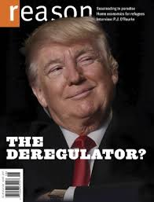
Unlikely Couple 2
Notes:
Rao was born to mother Zerin Rao and father Jehangir Narioshang Rao, both Parsi physicians from India^{[3]}, and raised in Bloomfield Hills, Michigan, where she was educated at Detroit Country Day School (class o
f 1991).^{[4]} After graduating from Yale University with highest distinction in ethics, politics, economics, and philosophy, Rao attended the University of Chicago Law School, where she was a member of the Order of the Coif and received her J.D. in 2000. She was the comment editor of the University of Chicago Law Review, and executive editor of the Harvard Journal of Law and Public Policy for the Symposium edition. Rao clerked for U.S. Supreme Court Justice Clarence Thomas^{[5]} from 2001 to 2002, and Judge J. Harvie Wilkinson III of the United States Court of Appeals for the Fourth Circuit from 2000 to 2001.
After her clerkships, she practiced public international law and arbitration at British law firm Clifford Chance in London, United Kingdom. During the second term of the presidency of George W. Bush, Rao worked in the White House counsel's office and as a staffer on the Senate Judiciary Committee.^{[5]} Later, she became a professor at George Mason University School of Law (subsequently renamed the Antonin Scalia Law School, a change for which she advocated),^{[5]}where she received tenure in 2012. In 2015, she founded the Center for the Study of the Administrative State.^{[6][5]}
She is a member of the Administrative Conference of the United States and the governing council of the American Bar Association's Section of Administrative Law and Regulatory Practice, where she co-chaired the section's regulatory policy committee.
As Judge on DC Cir, wrote Flynn I

Slide 41
Khan and Kahn
New Chairman
Lina Khan
Old Chairman
Alfred Kahn

Slide 42
In Our Discussion ,Let’s Distinguish
DEREGULATION
WEAK/UNDERFUNDED REGULATION
INEPT REGULATION
THE ABSENCE OF REGULATION
LAISSEZ-FAIRE
SKEPTICISM OF REGULATION
“GOVERNMENT IS THE ENEMY OF FREEDOM”

