Slide 1
Climate adaptation and resilience
Carter Brandon
World Resources Institute
October 18, 2022

Slide 2
overview
What are climate impacts? Economic, social, and environmental.
What is climate change adaptation? Resilience? Loss and Damage?
Why are damages getting worse?
Who should do what? How complicated is it? How to prioritize?
How can protecting nature help?
Some ideas to debate…

Slide 3
Warmer Temperatures

Slide 4
Rising Seas

Slide 5
Stronger Storms

Slide 6
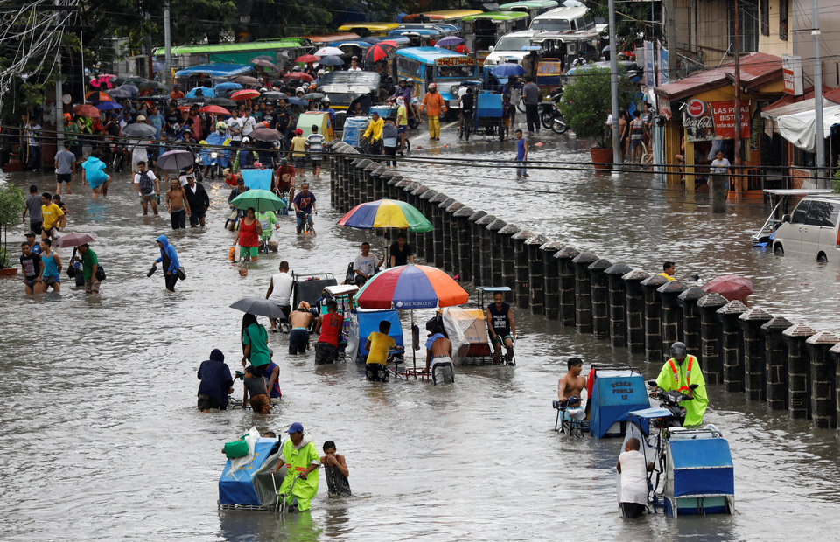
Flooding

Slide 7
Ocean Acidification

Slide 8
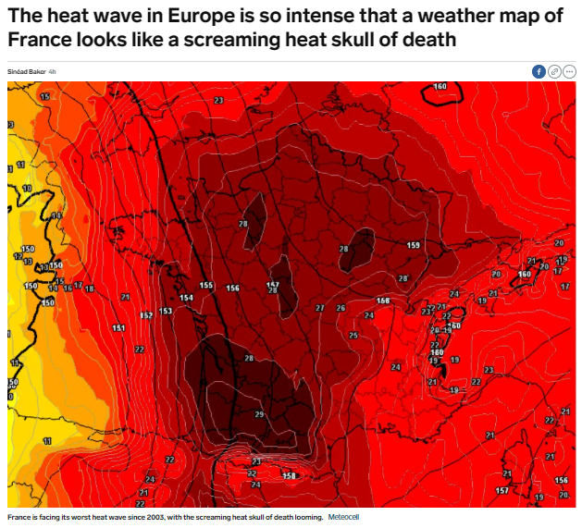
June 28, 2019

Slide 9
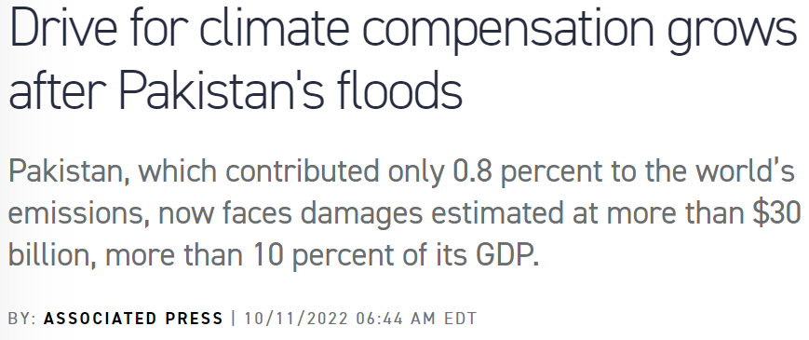
Adaptation, Resilience, Loss & damage

Slide 10
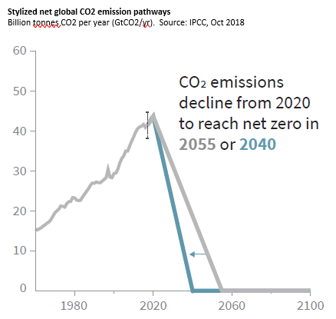
Emissions must fall by half by 2030 and reach net-zero by 2050 to reach the Paris Agreement 1.5 Celsius goal

Slide 11
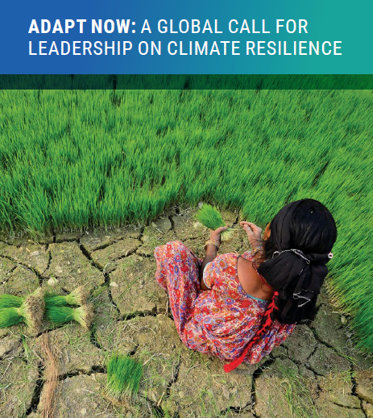
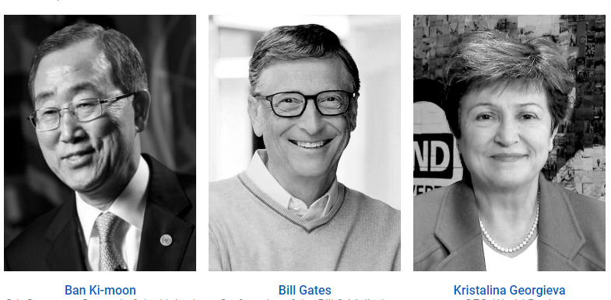
THE GLOBAL COMMISSION ON ADAPTATION

Slide 12
overview
What are climate impacts? Economic, social, and environmental.
What is climate change adaptation? Resilience? Loss and Damage?
Why are damages getting worse?
Who should do what? How complicated is it? How to prioritize?
How can protecting nature help?
Some ideas to debate…

Slide 13
The Climate Crisis: Extreme Costs to People + Nature + Economy
130+ million people fall into poverty by 2030
Over 200 million people migrating within their own country borders by 2050
Agriculture yields down 30% by 2050.
5 billion people lack regular water resources by 2050.
More than $1 trillion/year in damages to coastal cities by 2050.

Slide 14
Risk of Catastrophic Events Increases with Temperature
Notes:
Highly damaging scenarios are plausible, putting the Sustainable Development Goals (SDGs) out of reach, eroding hard-won gains from the past, and threatening the existence and livelihoods of many communities and societies
At higher temperature increases such as 3–4o C, it becomes almost certain that we will cross tipping points, or irreversible changes in ecosystems or climate patterns, which will limit our ability to adapt
This figure describes the magnitude and severity of consequences in key systems that are at risk
Figure source: World Resources Institute, adapted from the IPCC and others

Slide 15
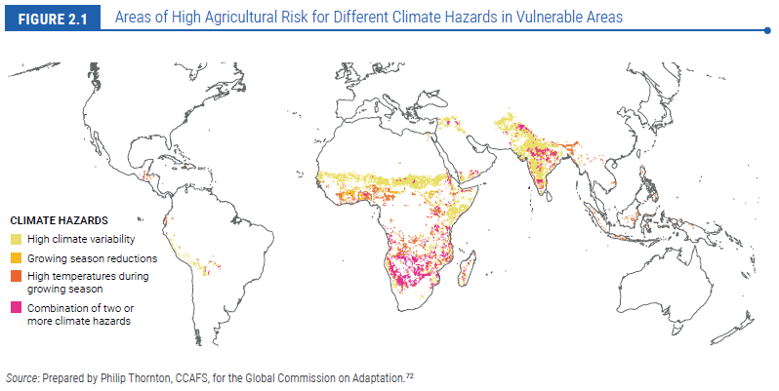
These areas face high potential for crop failure, starvation, and out migration.

Slide 16
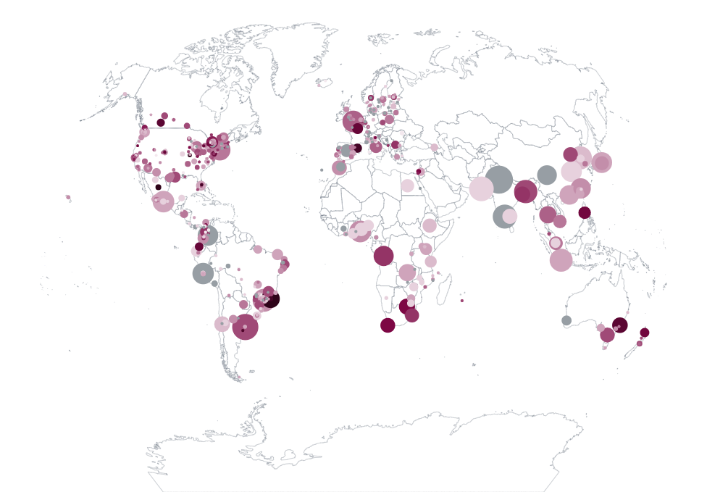
CITIES
10% of the world’s population lives in urban areas situated at less than 10 meters above sea level.
In 2018, 85% of cities already experienced major climate issues, from extreme heat waves to flooding.
Fewer than half have taken action.
https://blogs.ei.columbia.edu/2019/10/25/rising-seas-low-lying-coastal-cities/
The size of each circle is a city population. The darker the circle, the higher the self-reported climate risk.
https://www.cdp.net/en/research/global-reports/cities-at-risk

Slide 17
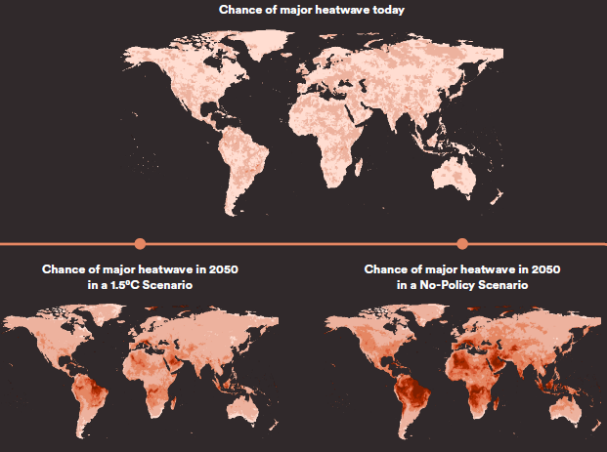
Risk of Major Heat Waves

Slide 18
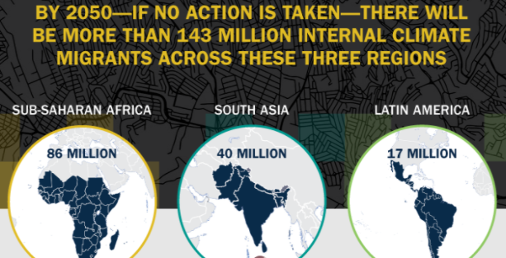
Climate-Induced Internal Migration
The poorest people will be forced to move due to climate change impacts, including:
Decreasing crop productivity
Shortage of water
Rising sea level
Increasing extreme events (floods, droughts, storms)
Heat
World Bank analysis looks only at internal migration – mainly to cities – and not cross-border.
SOURCE: World Bank, Groundswell, 2018

Slide 19
Up to 132 million people will fall into extreme poverty due to climate change by 2030… the same as due to COVID
Source: World Bank, 2022

Slide 20
An aggregate measure of vulnerability

Slide 21
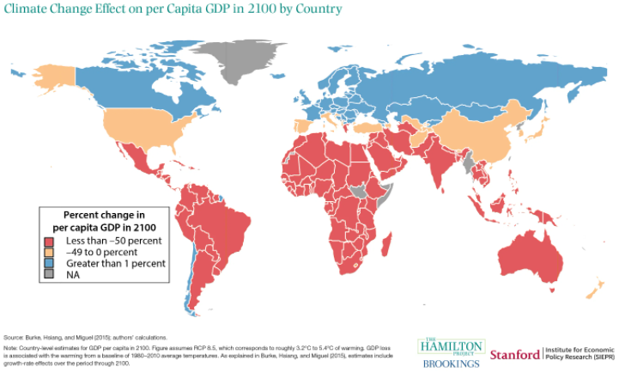

Slide 22
overview
What are climate impacts? Economic, social, and environmental.
What is climate change adaptation? Resilience? Loss and Damage?
Why are damages getting worse?
Who should do what? How complicated is it? How to prioritize?
How can protecting nature help?
Some ideas to debate…

Slide 23
Adaptation & Resilience – two visions
Reslience
Adaptation
Adaptation
Resilience
Resilience brings us back to where we were.
Adaptation prepares to be where we want to be in the future.
Adaptation helps us manage climate risks.
Resilience helps us manage all sorts of risks, including economic, health, governance, social, political, war…

Slide 24
The basic elements of climate change adaptation
Risk management
Risk reduction
SOURCE: Global Commission on Adaptation , Adapt Now, 2019

Slide 25
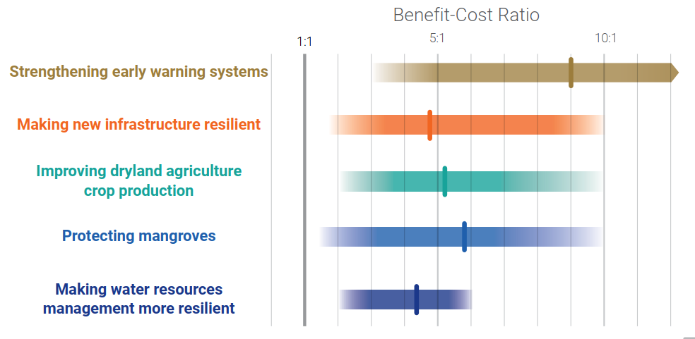
Benefits and Costs of Illustrative Investments in Adaptation
The economic benefits of global adaptation investments, WRI, September 2019

Slide 26
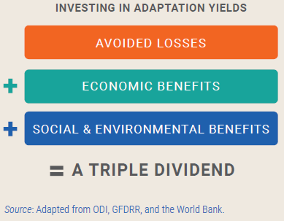
Climate adaptation offers a triple dividend
Climate-resilient infrastructure adds 3% to upfront costs but has benefit-cost ratios of 4:1
Sea walls allow urban development;
dryland farming practices increase yields
Nature-based flood protection also increases biodiversity, makes the air and water cleaner, offers recreation, and improves health.

Slide 27
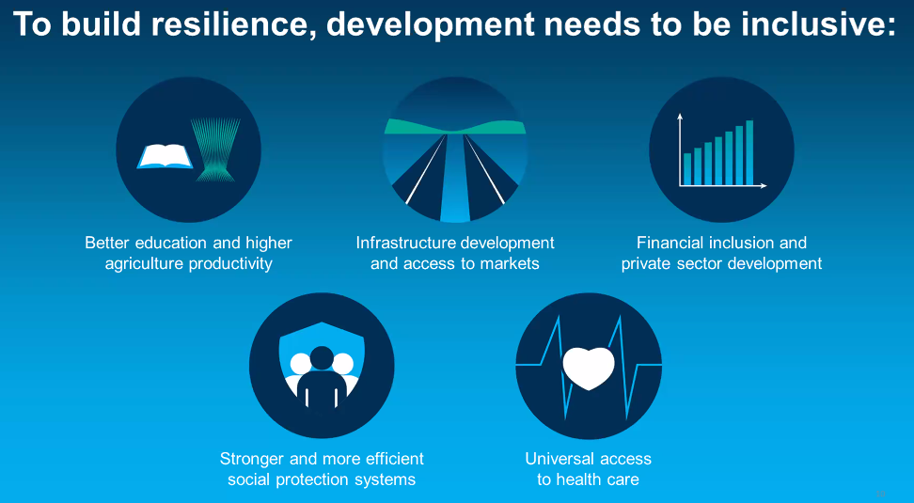
Source: World Bank, 2022

Slide 28
overview
What are climate impacts? Economic, social, and environmental.
What is climate change adaptation? Resilience? Loss and Damage?
Why are damages getting worse?
Who should do what? How complicated is it?
How to prioritize? Balancing risk reduction (i.e., a priori investments) with risk management (i.e., ex post recovery)
Some ideas to debate…

Slide 29
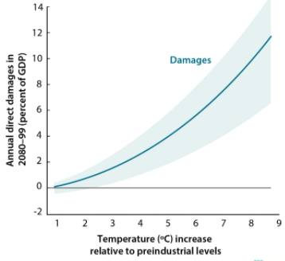

Slide 30
Why are climate change damage estimates going up?
Climate change impacts are getting worse over time, with increased concern for tipping points.
Total exposed asset values are rising – buildings, infrastructure, systems.
In addition to damaged assets, we understand better complex impacts on health, nutrition, agricultural yields, lost education, and crime.
The size of the affected population is growing, especially in coastal areas. It is also getting older, which means more vulnerable.
Per capita incomes of the affected population are rising, which means greater losses.
Vulnerable areas, especially around cities, are expanding (e.g., hillside slums).
Increasing environmental degradation decreases resilience, such as for flooding, heat, and agricultural productivity.
The multiplier effect of disrupted supply chains.
Estimated costs vary strongly with the assumptions made, particularly concerning future emissions, baseline assumptions, and the methods used to estimate both

Slide 31
overview
What are climate impacts? Economic, social, and environmental.
What is climate change adaptation? Resilience? Loss and Damage?
Why are damages getting worse?
Who should do what? How complicated is it? How to prioritize?
How can protecting nature help?
Some ideas to debate…

Slide 32
A Framework for Climate Impacts and Responses (1)
Physical climate risks | Impact on the economy and on human welfare | Economic sectors | Responsible Agencies
Higher air temperatures
Higher ocean water temperatures
Sea level rise
More intensive storms
Changing rainfall patterns

Slide 33
A Framework for Climate Impacts and Responses (2)
Physical climate risks | Impact on the economy and on human welfare | Economic sectors | Responsible Agencies
Higher air temperatures | Diseases spreading, heat stress, reduced agricultural yields
Higher ocean water temperatures | Coral reef die-off; changes in fisheries productivity
Sea level rise | Coastal flooding; coastal degradation
More intensive storms | Flooding, asset damage, income loss, reduced nutrition
Changing rainfall patterns | Changing ecosystems and land use (often loss of forests and agriculture land); reduced yields; change in freshwater reserves

Slide 34
A Framework for Climate Impacts and Responses (3)
Physical climate risks | Impact on the economy and on human welfare | Economic sectors | Responsible Agencies
Higher air temperatures | Diseases spreading, heat stress, reduced agricultural yields and changing cropping patterns | Health; construction; infrastructure; agriculture; water
Higher ocean water temperatures | Coral reef die-off; changes in fisheries productivity | Fisheries, coastal communities; tourism
Sea level rise | Coastal flooding | Coastal communities, cities, infrastructure, disaster risk management
More intensive storms | Flooding, asset damage, income loss, reduced nutrition | Agriculture, cities, infrastructure, disaster risk management, tourism
Changing rainfall patterns | Changing ecosystems and land use (often loss of forests and agriculture land); reduced yields; change in freshwater reserves | Agriculture; land use; forestry; nutrition; infrastructure (e.g., water, hydro, transport, cities); social safety nets
Notes:
Min of Agriculture, Livestock, Fisheries
Min of Energy
Min of Transport
Min of Water Resources, Water Supply, Sanitation
Min of Environment and Forests
Min of Health
Min of Education
Min of Finance
Min of Planning
Min of Urban Development
Municipalities and local authorities
Min of Tourism
National Meteorological Agency

Slide 35
A Framework for Climate Impacts and Responses (4)
Physical climate risks | Impact on the economy and on human welfare | Economic sectors | Responsible Agencies
Higher air temperatures | Diseases spreading, heat stress, reduced agricultural yields | Health; construction; infrastructure; agriculture; water | Global, Federal, State and Local agencies are all involved: Planning Finance Agriculture, Livestock, Fisheries Energy Transport Water Supply, Sanitation Environment Forestry and Parks Health Education Urban Development Commerce and Tourism National Meteorological Agency (NOAA in the US)
Higher ocean water temperatures | Coral reef die-off; changes in fisheries productivity | Fisheries, coastal communities; tourism
Sea level rise | Coastal flooding | Coastal communities, cities, infrastructure, disaster risk management
More intensive storms | Flooding, asset damage, income loss, reduced nutrition | Agriculture, cities, infrastructure, disaster risk management, tourism
Changing rainfall patterns | Changing ecosystems and land use (often loss of forests and agriculture land); reduced yields; change in freshwater reserves | Agriculture; land use; forestry; nutrition; infrastructure (e.g., water, hydro, transport, cities); social safety nets
High complexity
Notes:
Min of Agriculture, Livestock, Fisheries
Min of Energy
Min of Transport
Min of Water Resources, Water Supply, Sanitation
Min of Environment and Forests
Min of Health
Min of Education
Min of Finance
Min of Planning
Min of Urban Development
Municipalities and local authorities
Min of Tourism
National Meteorological Agency

Slide 36
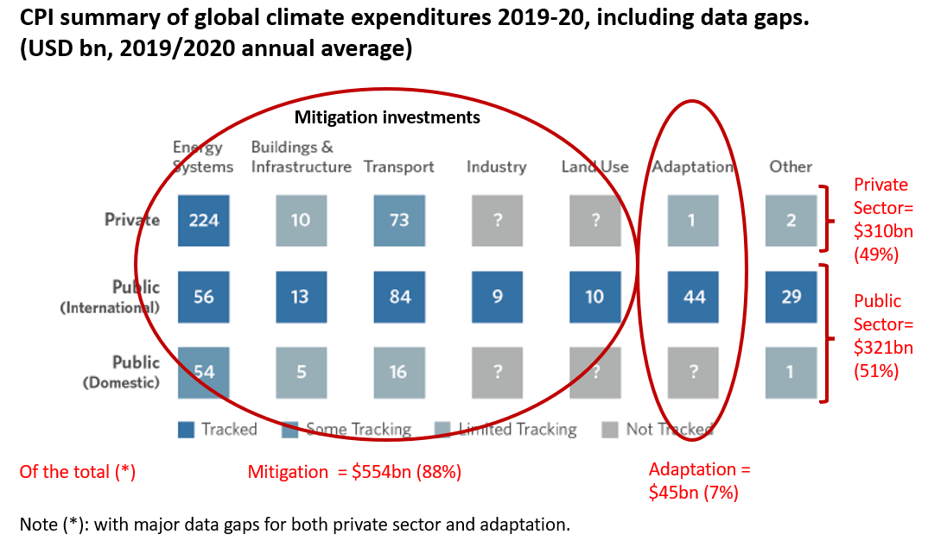
Climate Policy Initiative, 2021

Slide 37
“We cannot survive an unabated climate crisis, so mobilizing today for a more resilient tomorrow is exactly what we should do,” Kristalina Georgieva, the IMF’s managing director.
The world spends around $630 billion to reduce planet-warming emissions and adapt to climate impacts, but the needs are between $3 trillion and $6 trillion, Georgieva said, noting: “We are not even close to this number.”
IMF, October 11, 2022

Slide 38
Principles to guide public investments
Invest in efficiency in all sectors (no regrets)
Avoid “lock-in” effects (evaluated against future trends)
Build on public sector capabilities
Promote locally-led adaptation, job creation and innovation
Balance risk reduction (i.e., sea walls, zoning measures, drought-resistant crops) and risk management (i.e., social safety nets, fiscal buffers, evacuation planning).
Maximize co-benefits (between development and climate benefits, between public and private benefits, and between nature and people benefits)

Slide 39
overview
What are climate impacts? Economic, social, and environmental.
What is climate change adaptation? Resilience? Loss and Damage?
Why are damages getting worse?
Who should do what? How complicated is it? How to prioritize?
How can protecting nature help?
Some ideas to debate…

Slide 40
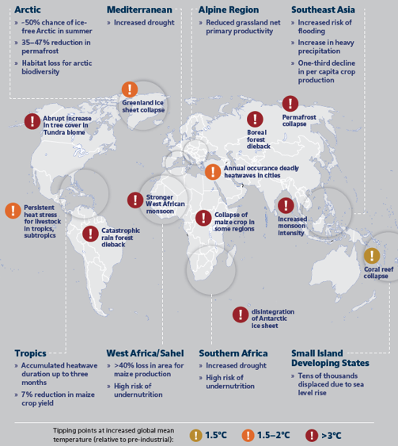
GLOBAL TIPPING POINTS
Permafrost Collapse
Ice Sheet Collapse
Boreal Forestry Dieback
Coral Reef Collapse
Catastrophic Rainforest Dieback
Atlantic Circulation Slowdown
Atlantic circulation slowdown
They will affect all latitudes.
Ecosystem & biodiversity loss is happening in tandem.
Best estimates are that they will add another 25-30% to the global cost of climate impacts by 2050.
SOURCE: World Bank, climate adaptation action plan, Jan. 2019

Slide 41
Nature-Based Solutions (NBS) are fundamental to both climate mitigation and adaptation
All Nature-based Solutions (NBS):
“Actions to protect, sustainably manage, and restore natural or modified ecosystems, that address societal challenges effectively and adaptively, simultaneously providing human well-being and biodiversity benefits”.
Sectoral focus:
Water
Food
Cities
Infrastructure
Health
Disaster risk management
Supply Chains
NBS for climate mitigation:
Carbon sequestration through forest protection, reforestation and afforestation
Notes:
Easily measured in terms of net emissions impact
Increasing focus in Nationally Determined Contributions (NDCs)
NBS for climate adaptation:
Flood control
Water quality
Water provision
Coastal Protection
Soil retention
Urban cooling
Health
Notes:
Very little integration into NDCs
Hard to plan and measure

Slide 42
Relationships Between the Natural Environment and Climate Change Adaptation by Sector

Slide 43
overview
What are climate impacts? Economic, social, and environmental.
What is climate change adaptation? Resilience? Loss and Damage?
Why are damages getting worse?
Who should do what? How complicated is it? How to prioritize?
How can protecting nature help?
Some ideas to debate…

Slide 44
Managing climate change and sustainability – where do you start?
Current
vs Future Generations
It’s all about trade-offs
Top-down vs Bottom-up
Consumption vs Investment
Incentives vs Rights
People
vs Nature
The rich vs the poor

