Slide 1
LECTURE 1: Air We Breathe
Course Overview
Americans now live indoors 90% of the time
Each breath has particles and each particle has its own story
Each breathe has particles sourced at many levels:
-Global example: dust particle from Chad to Miami (TU)
-Regional example: aviation, air quality (W)
-Local example: combustion exhaust + atmospheric biota (TH)
-Indoor example: dust mites + co-exist with multitudes (F)
Particle size, particulate matter (PM) is a measure of harm
Smaller particles do more systemic harm to entire body

Slide 2
LECTURE 1: Air We Breathe
Science literacy (science appreciation) is our lens on air we breathe
Air, its particles and each particle’s history and origins.
Science literacy includes methods, narrative & experiential accounts
Point 1: Science fiction inspires complex research experiments
“Atmosphaera Incognita” by Neal Stephenson
Point 2: Science as one way of knowing
Point 3: Relationship of science to society is dynamic
Point 4: Rise of fake science is eroding societal trust

Slide 3
Point 1: Science fiction
inspires complex
research goals
“Atmosphaera Incognita”
by Neal Stephenson
Class Question:
What do you want to know
about this tower’s
ascending altitudes
from 0 to 20 km?

Slide 4
Excerpt from “Atmosphaera Incognita” science fiction story by Neal Stephenson

Slide 5
LECTURE 1: Air We Breathe
Point 1: Science fiction inspires
What are our class questions?

Slide 6
LECTURE 1: Air We Breathe
Science literacy
Point 2: Science as one way of knowing. Chapter 14 “Sapiens” Y.N. Harari
Scientific method is a system for gaining authenticated knowledge
Q: What is authenticated knowledge and now is it built?
A: Paraphrased from Kevin Kelly The Technium
“Science is the…organization of knowledge [so] that
Knowledge can be tested
New varieties of knowledge can appear
It can be archived and restored
It can be communicated without grave error
It can be built upon and extended, and most importantly
Science is the method whereby knowledge is structured so that it can be structured further.”

Slide 7
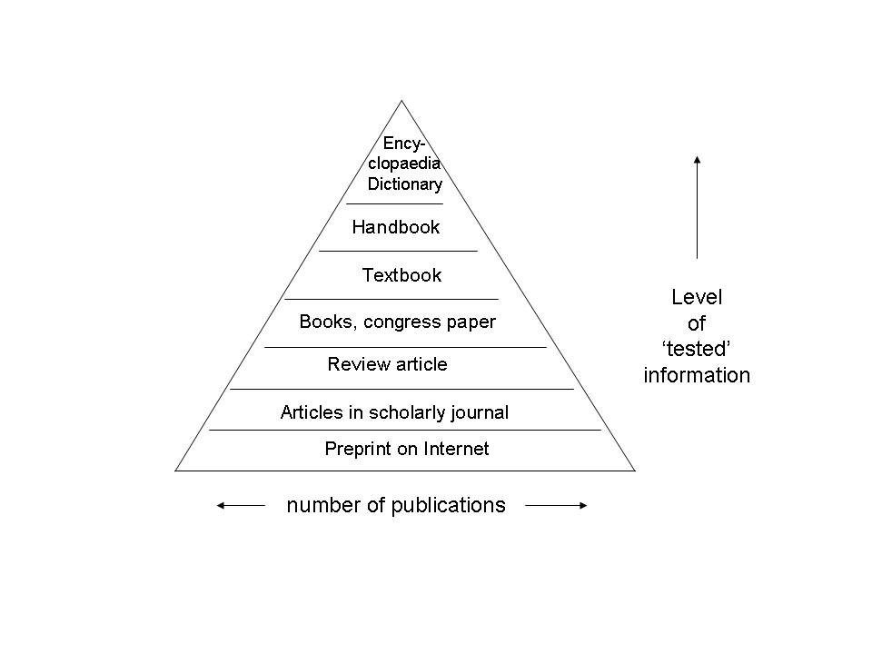
LECTURE 1: Air We Breathe
Science literacy
Point 2: Science as one way of knowing.
Authenticated knowledge
+ its hierarchy
is not apparent from
Internet browsing
Authenticated
knowledge
has a
structure
+ ranking
Google and other Internet browsers
Secondary
Primary sources
are preferred
Source: http://courses.eurlib.nl/course.cfm?course=
Scholarly+publishing&page=The+literature+pyramid

Slide 8
LECTURE 1: Air We Breathe
Point 3: Relationship of science to a society is dynamic
Scientists as heroes
Sputnik in 1957 U.S. Race to the Moon
Cancer cure
Scientists as doomsday sayers
Covid19 in 2020
Climate change
Other ways of knowing, not science, can take precedence in policy & politics

Slide 9
LECTURE 1: Air We Breathe
Point 4: Rise of fake science is eroding societal trust (Beall 2016)
Appetite for fake science, embedded inside public policy + politics

Slide 10
LECTURE 1: Air We Breathe
Point 4: Internet’s appetite for fake science fuels public policy + politics

Slide 11
“Dear Dr. Claire G Williams,
“Austin Environmental Sciences (ISSN: 2573-3605), Impact factor 1.9”, aims to publish high quality papers, Alternative and Integrative medical research. Journal is organizing a special issue on “Air Pollution”. This journal facilitates the research and wishes to publish papers as long as they are technically correct, scientifically motivated. The journal also encourages the submission of useful reports of research results. Journal covers all areas of clinical & medical sciences and publishes case reports, case series, clinical images and presentations. This is a quality controlled, OPEN peer reviewed, open access INTERNATIONAL journal. Article Published: (18-25 days). Kindly send your article in MS word format.
With Regards,
Rebecca Williams
Editorial Office- Austin Environmental Sciences
Austin Publications LLC
6565 N MacArthur Blvd Ste 225,
Irving Tx 75039, USA,
Call: +1-201-655-7075.”

Slide 12
Predatory journals, conferences, books Example Monday February 5 2024
“Dear Dr. Williams CG,
I hope this message finds you well. I'm honored to invite you to speak at 3rd Global Conclave on Advanced Cardiology and Cardiovascular Innovations (Adv. Cardiology 2024) held during June 27-28, 2024 at Amsterdam, Netherlands.
We would be delighted to have you present as a Distinguished Speaker at this conference to give an oral presentation on your publication titled "Changing particle content of the modern desert dust storm: a climate?�?health problem.". We'd love to hear your thoughts and opinions on this study, or you can also choose any other paper from your research that is relevant to Adv. Cardiology 2024. Kindly let me know your interest for participating at the conference so that I will send you further details. For more details, Click Here: Cardiology Conferences
Look forward to receive your positive response. Attention...: Interested in attending this event with sponsorship? Please reach out to us by email.
Warmest Regards, Shena Hodiah Program Director Peers Alley Media 1126 59 Ave East, V5X 1Y9 Vancouver BC, Canada”

Slide 13
LECTURE 1: Air We Breathe
Overview
Each breathe is air and particles which originate far and near
-global -regional –local -indoor
Each particle has its own trail - or trajectory
Trajectory: sourced or emitted, entrainment, transport and deposition
-particle load is a shared global commons
-transport horizontal and vertical
-transport linked to atmosphere’s motion, layering and gradients
-studying particles in a breathe is a multidisciplinary project
-tracing articles varies in time and space, scales 15 orders of magnitude

Slide 14
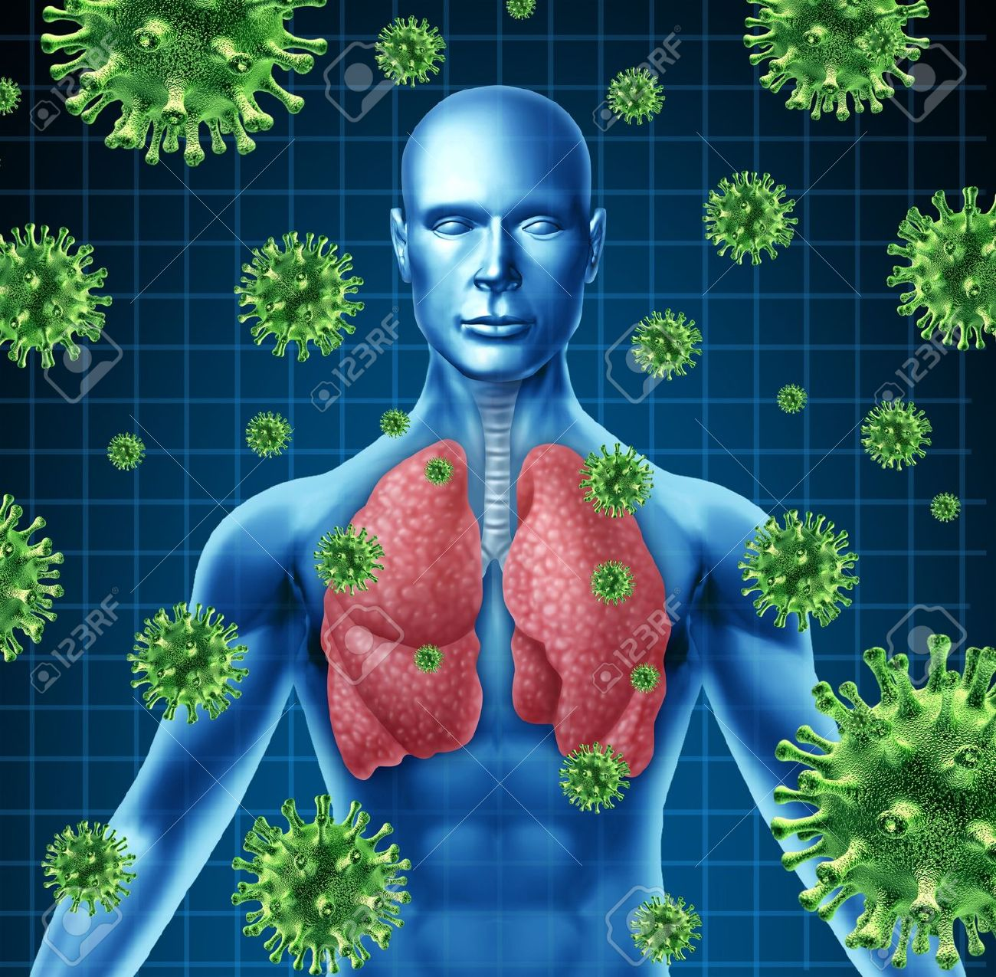
The Air We Breathe

Slide 15
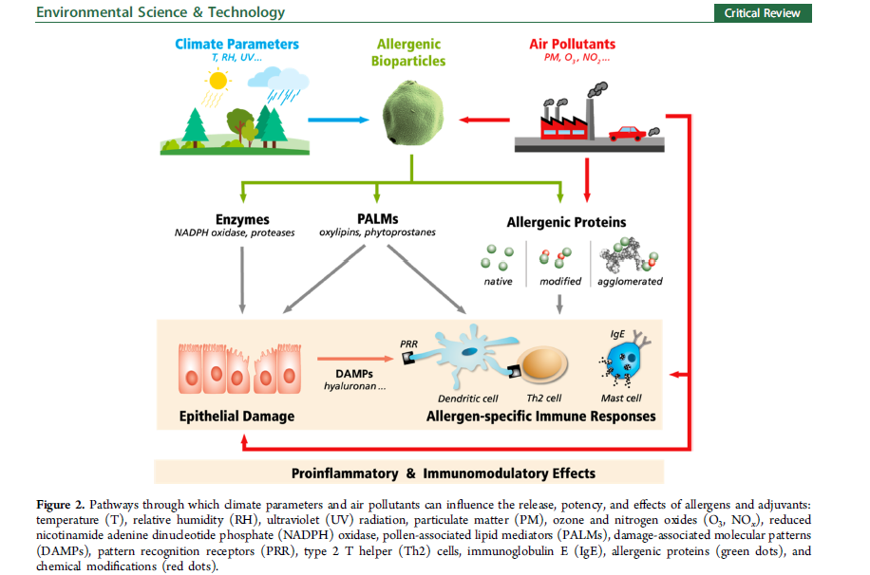

Slide 16
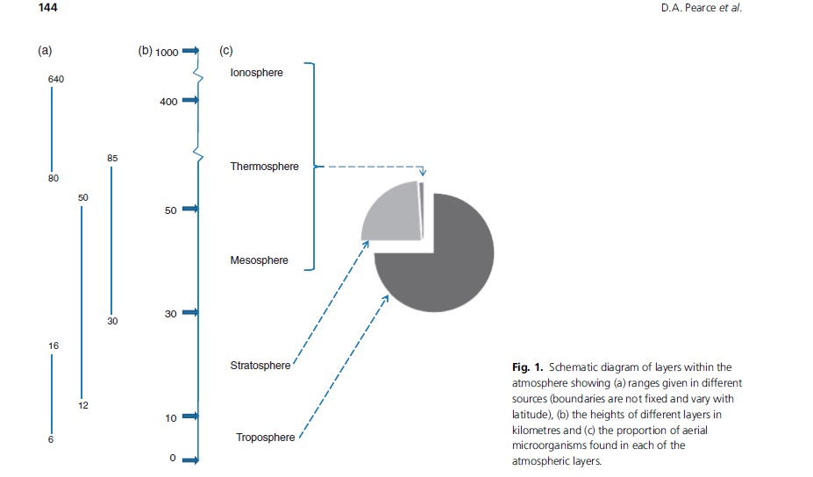
Class focus:
Stratosphere
Troposphere

Slide 17
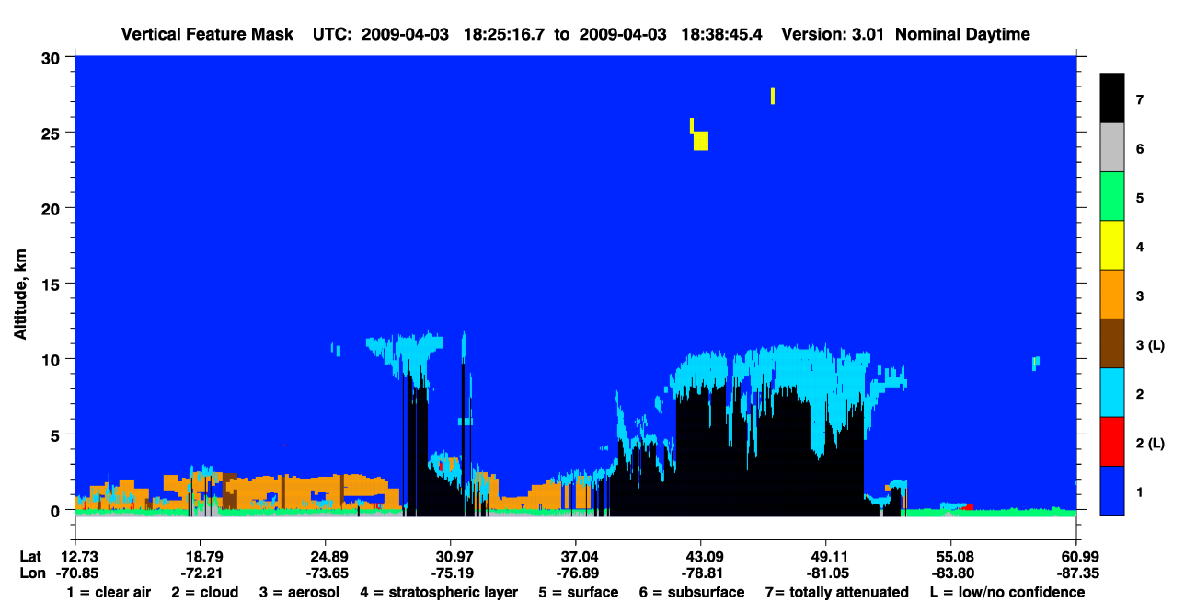
Atmospheric
Layers
Tropopause
11.3 km
-12 C @ 5 km
Inversion 2.9 km
Planetary
Boundary
Layer (PBL)
1.9 km

Slide 18
