Slide 1


Slide 2


U.S.-Mexico ties touch more U.S. lives daily than any other country via trade, border connections, tourism, family ties, and illicit flows. An “Inter-Mestic” Relationship.
Some 37 million Mexican-Americans: 11% of the U.S. population.
1990-mile border (3,201 km) with security, economic, family & environmental interests.
2010-16: government collaboration unprecedented; tensions and cooperation 2017-21.
2020: U.S., Mexico, and Canada trade accord launched (USMCA); trade rising since.
2021-23: Rebuilding cooperation on migration, border, crime, trade, enhancing competitiveness. But big challenges on these issues too!
Notes:
http://www.pewhispanic.org/2015/09/15/hispanics-of-mexican-origin-in-the-united-states-2013/
https://www.pewresearch.org/hispanic/fact-sheet/u-s-hispanics-facts-on-mexican-origin-latinos/
37 million
https://data.census.gov/cedsci/table?q=B03001%3A%20HISPANIC%20OR%20LATINO%20ORIGIN%20BY%20SPECIFIC%20ORIGIN&g=&lastDisplayedRow=30&table=B03001&tid=ACSDT1Y2018.B03001&hidePreview=true
2019: ACS 1-Year Estimates Detailed Tables
Mexican origin in population- 37, 186, 361
https://data.census.gov/cedsci/table?q=B03001%3A%20HISPANIC%20OR%20LATINO%20ORIGIN%20BY%20SPECIFIC%20ORIGIN&y=2019&tid=ACSDT1Y2019.B03001&hidePreview=true

Slide 3
Serious Challenges and Opportunities to Address
U.S. drug demand, Fentanyl deaths, Mexican traffickers, US guns
Boost commerce, jobs; build resilient supply chains
Build a 21st century border to handle trade, crime, migrants
Manage migration: Mexico Central Am & elsewhere
Implement USMCA, solve disputes, 2026 review
Security Cooperation: Need results from Bicentennial Framework
Boost North Am. Cooperation
Negative public perceptions; deepen stakeholder dialogues
Face Democratic Backsliding
Notes:
Polls in speech (added already in sources)
-Maybe replace Modernizing NAFTA with AMLO-Trump Relationship

Slide 4
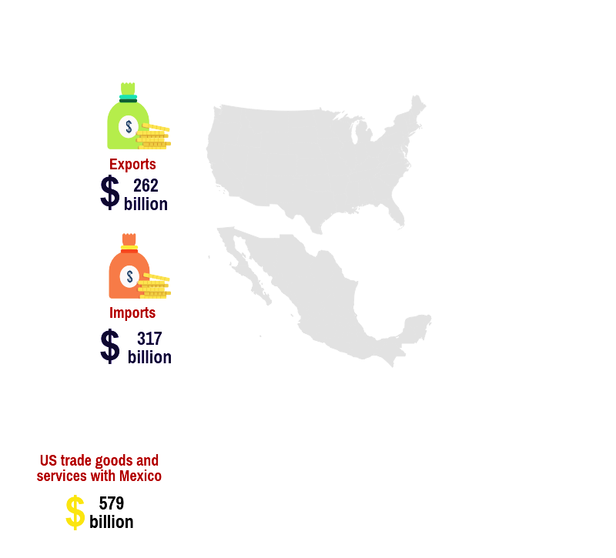
Trade: Mexico #1 in 2023 with 15.7% of US trade
Mexico is the U.S.’:
was the US' largest trade partner at $298.8 billion in 2023
Surpassed China as the US' largest supplier of imports in 2023
1st agricultural trading partner (14.5% US exports 2022)
1st or 2nd export market for 28 states, 1st export market southern Border States
In 2021 & 2022, Mexico was 2nd largest US trade partner.
Total goods trade grew rapidly since USMCA began in 2020.
In 2023: Mexico 15.7% of trade; Canada 15.2%; China 11.3%.
2023 US deficit with Mexico was also highest ever: $152.4 billion.
Canada remains largest US export market; with Mexico #2.
For Mexico, US trade accounts for 80%+ of Mexican exports & 39% of GDP.
Notes:
BEA and Census match
2016 only goods

Slide 5
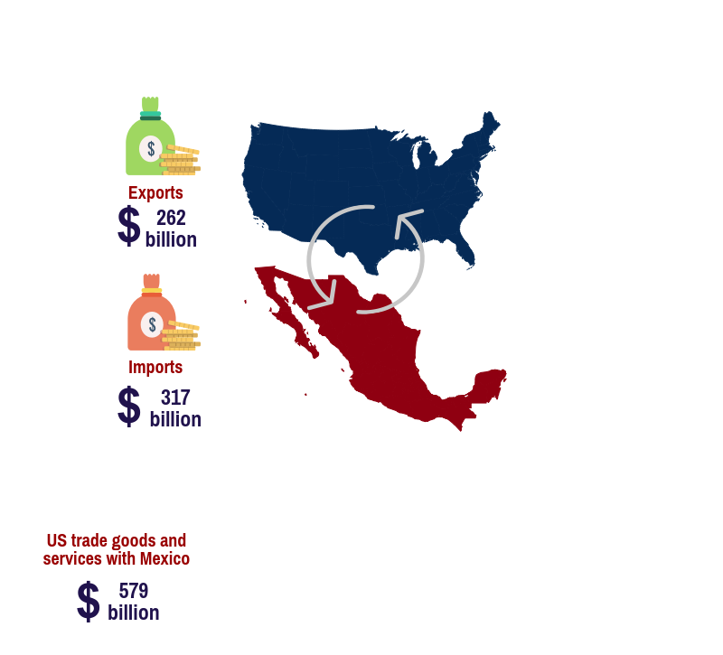
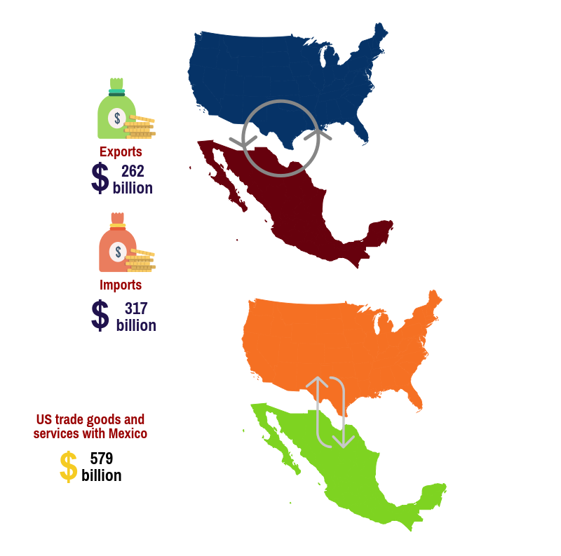
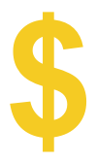
U.S.-Mexico Goods plus Services Trade: over $1.5 million a minute
2023 Trade in goods
$798.8 Billion
$322.2 Billion
Services trade est. $50 b.
means
$1.5 million dollars per minute in goods & services
$475.6 Billion
Currency in USD. Source: US Census
Notes:
https://ustr.gov/countries-regions/americas/mexico
https://www.bea.gov/newsreleases/international/trade/tradnewsrelease.htm
New 2018: https://www.census.gov/foreign-trade/Press-Release/current_press_release/ft900.pdf

Slide 6

Border Crossings back to pre-COVID levels
Each day over
1 million
border crossings
Source: Bureau of transportation statistics, 2021
Notes:
https://explore.dot.gov/views/BorderCrossingData/CrossingRank?%3Aembed=y&%3AisGuestRedirectFromVizportal=y

Slide 7
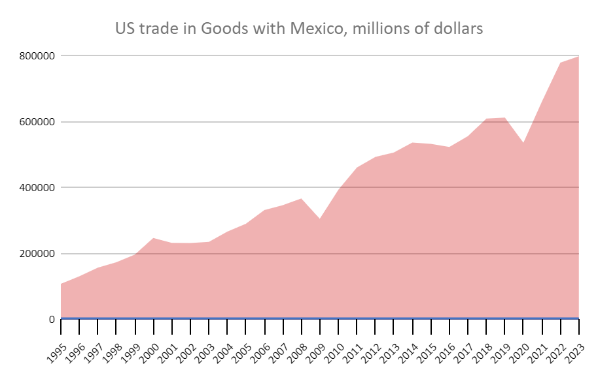

US-Mexico trade multiplied by over 6 times since 1995
The U.S. sells more to Mexico than to all the BRICS countries together
Over 98%
From 2010 to 2023
Source: The Wilson Center, “Charting a new course”, 2017; US Census Bureau, 2010, 2022.
Notes:
https://www.census.gov/foreign-trade/balance/c2010.html
FY 2010: 163,664 + 229,985= 393,649
FY 2018: 265,442 + 346,100= 611,542
FY 2019: 256,374 + 358,126= 614,500
FY 2020: 235,927 + 347,040= $582,967
Trade did go up from 2018 to 2019
Trade did increase by over 56% from 2010 to 2019
Due to pandemic, Trade decreased from 2019 to 2020 by 5.13%

Slide 8

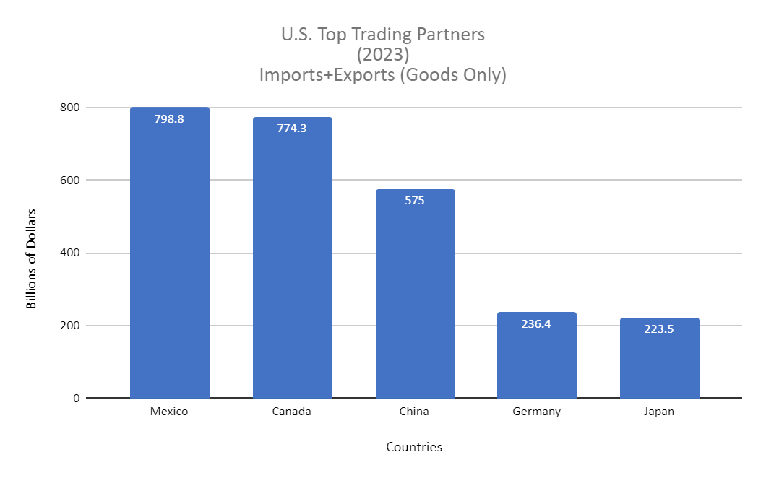
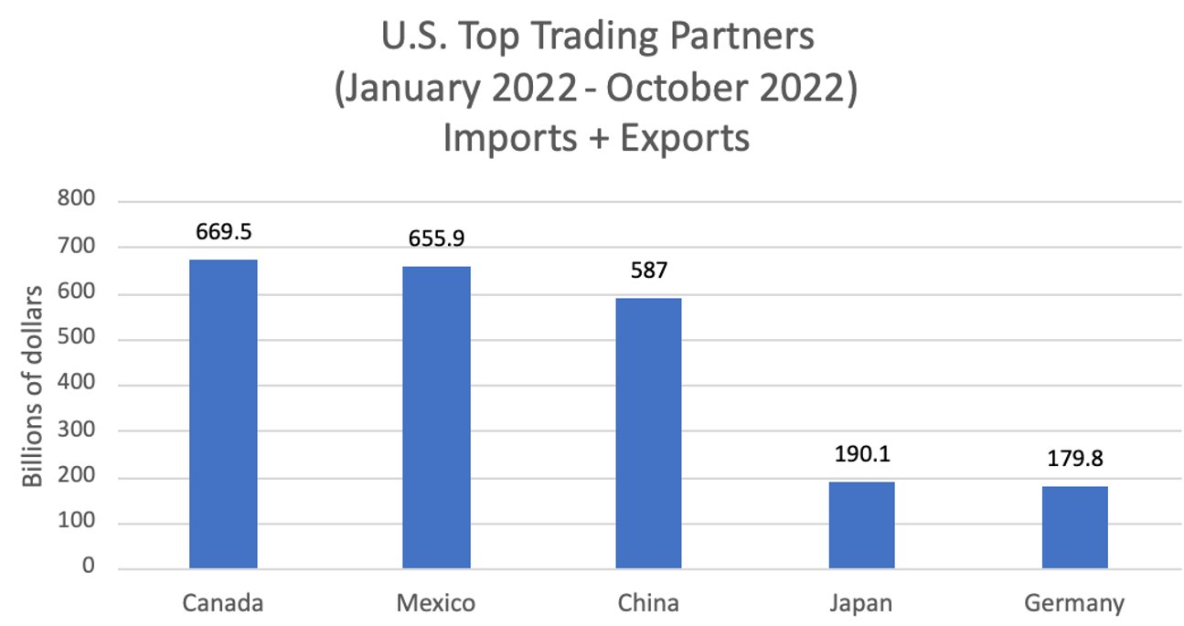
2023: Mexico is top trading partner in goods
https://www.census.gov/foreign-trade/statistics/highlights/topyr.html
Notes:
UPDATE Sep 20 2022: https://www.census.gov/foreign-trade/statistics/highlights/top/top2207yr.html
Up to December 2019: Mexico (615) Canada (612) China (559) Japan (218) Germany (188)
December 2020: China (560.1) Mexico (538.1) Canada (525.8) Japan (183.6) Germany (172.9)
Last updated Sept 2nd, 2021
Last updated Nov. 16, 2021 https://www.census.gov/foreign-trade/statistics/highlights/top/top2109yr.html

Slide 9
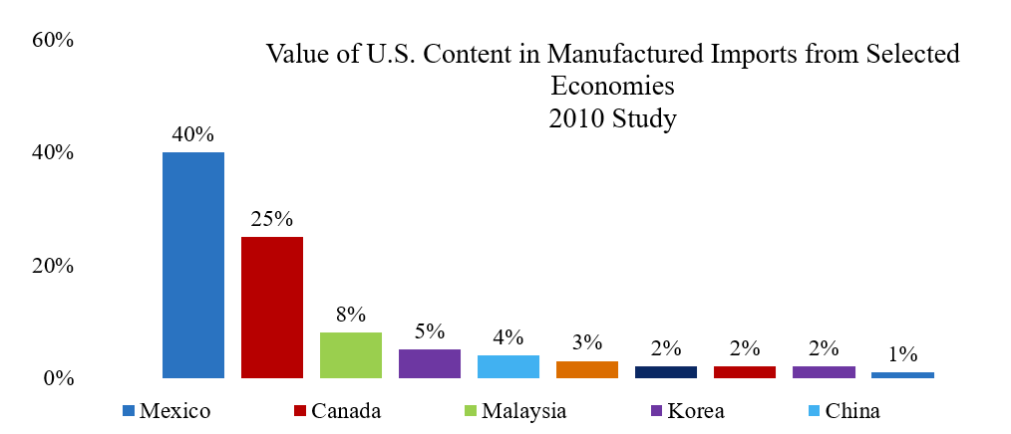
More U.S. Content in Imports from Mexico and Canada
Source: Robert Koopman et al. “Give Credit Where Credit is Due: Tracing Value Added in Global Production Chains”. NBER Working Paper No 16426.

Slide 10

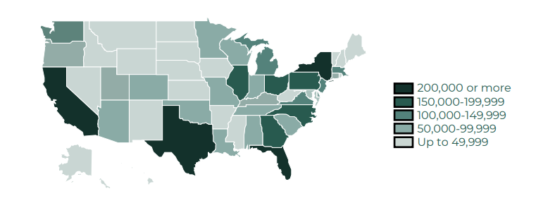
Mexico trade and investment supports
over 5 million U.S. jobs
Some 5 million US jobs depend on trade and investment ties with Mexico (2022), compared to an estimated 700,000 jobs in 1993.
Source: Mexican Embassy, 2023

Slide 11
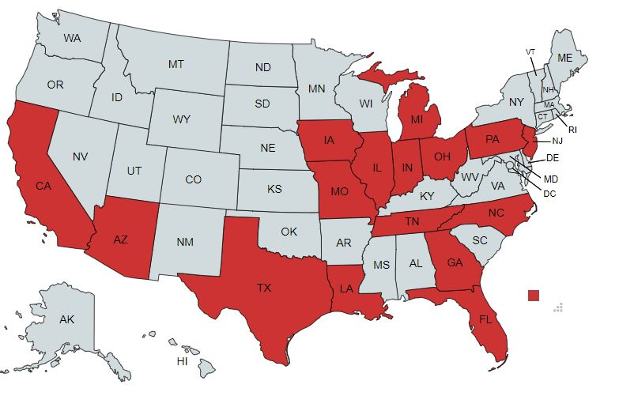
Rank Order: Top U.S. States’ Exports To Mexico 2023
State | Volume $USD (Billions) | State | Volume $USD (Billions)
Texas | 129.5 | Oregon | 6.5
California | 33.2 | Tennesse | 6.1
Michigan | 14.5 | Pennsylvania | 5.4
Illinois | 12.9 | North Carolina | 5.4
Ohio | 8.2 | Georgia | 4.8
Arizona | 8.0 | Wisconsin | 4.3
Indiana | 7.5 | Florida | 4.2
Lousiana | 6.9 | Missouri | 3.8
Source: ustrade.census data, 2024

Slide 12
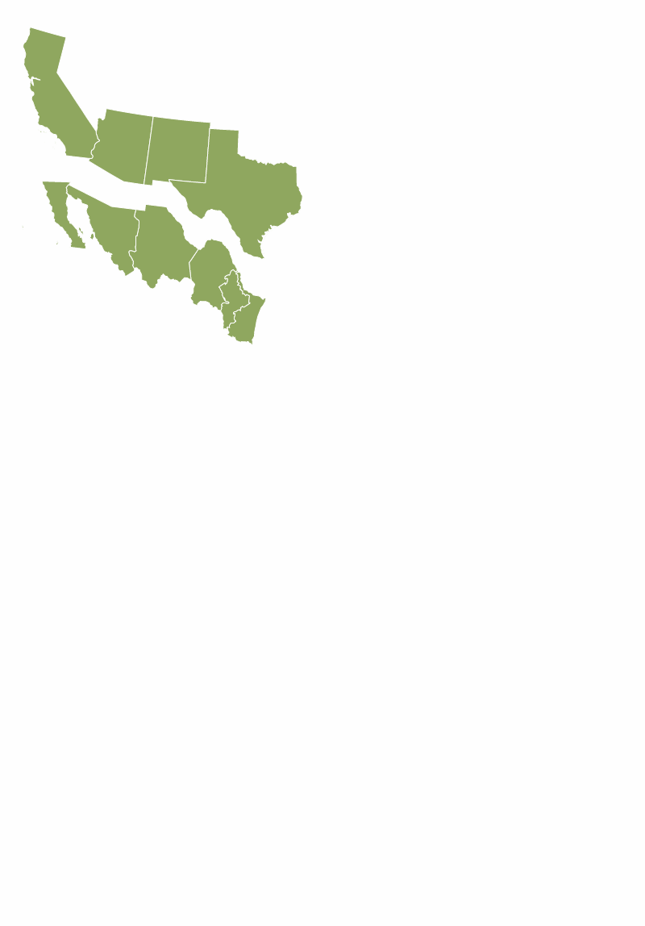





U.S.-Mexico Border States
In 2021, the U.S.-Mexico Border States’ GDP reached $6.2 trillion
GDP from both sides of the border would constitute the 3rd or 4th largest economy in the world.
Largest economies in the world (2022)
United States: $22.9 trillion
China: $17.7 trillion
Japan: $4.9 trillion
Germany: $4.2 trillion
(EU $17.1 trillion)
Source: Mexico Institute calculations based on the US Bureau of Economic Analysis, 2018 and INEGI, 2018
Notes:
https://data.worldbank.org/indicator/NY.GDP.MKTP.CD

Slide 13
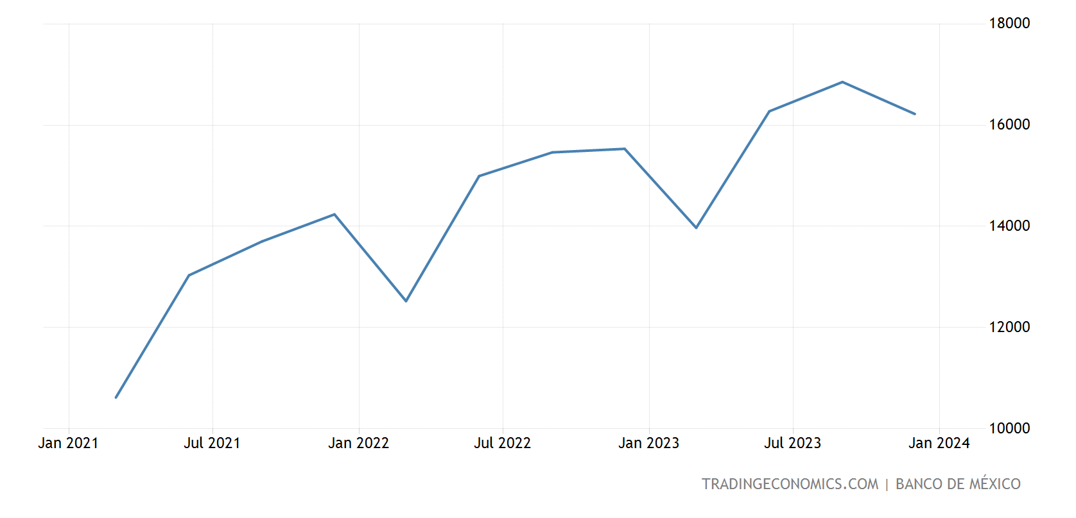
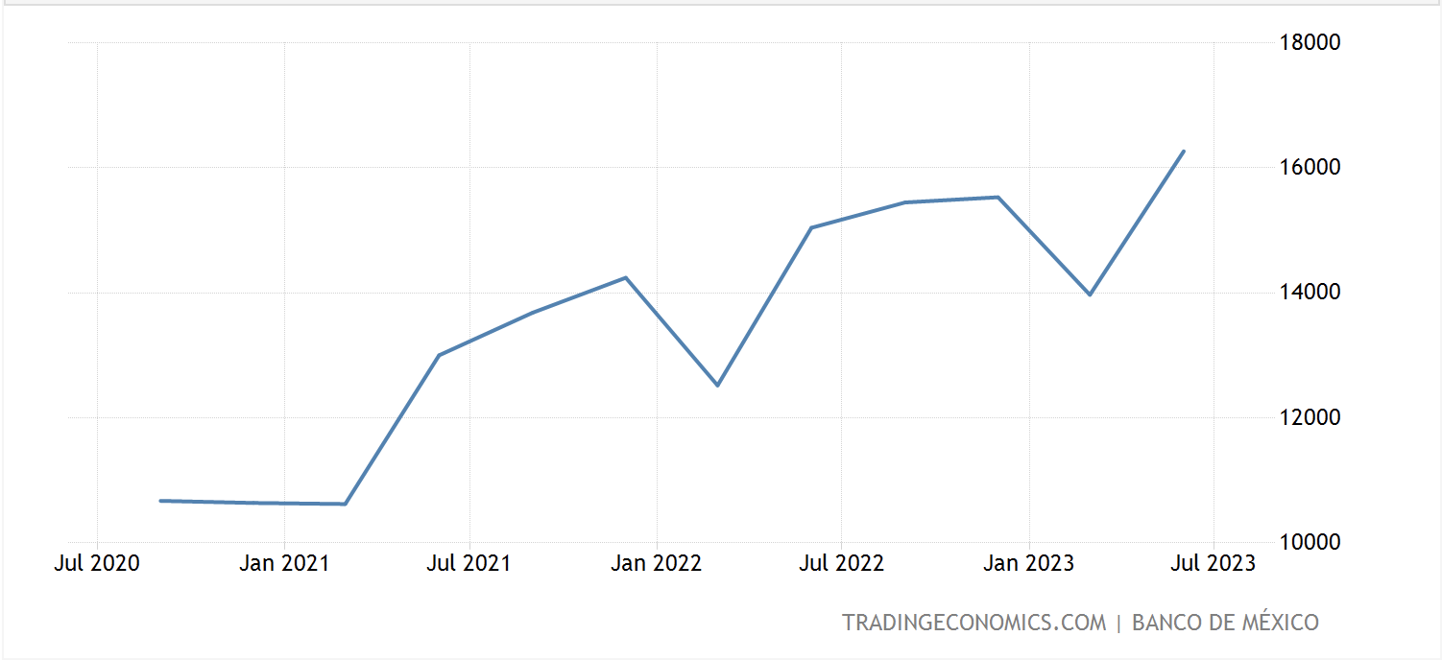
Another Plus for Mexico: Jump in US Remittances - Money sent to family and friends in Mexico.
Mexico’s Central Bank estimates that 95% of the remittances to Mexico come from the United States.
In 2023, remittances set a record of US $63 billion.
Only India received more remittances in 2022.
7-10% may be crime related says a Reuters report.
Notes:
Graphic for July data (released Sept. 2021)https://www.bloomberg.com/news/articles/2021-09-01/mexico-remittances-break-record-on-strong-u-s-growth?sref=iHOjTugq
https://www.bloomberglinea.com/2022/02/01/remittances-to-mexico-reach-record-516b-in-2021/#:~:text=Bloomberg%20%E2%80%94%20Mexico%20received%20a%20record,Bank%20of%20Mexico%20on%20Tuesday.
February 2023
This is the link where you will find updated charts. Play around with the "chart" format for desired form.
https://tradingeconomics.com/mexico/remittances

Slide 14
Border Management:
Licit and Illicit Flows

Slide 15
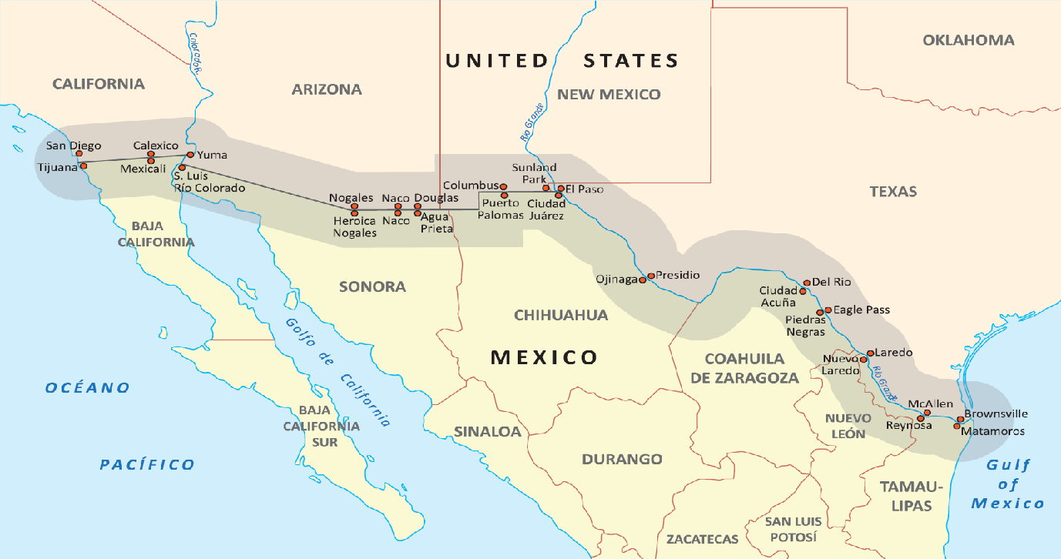
Moving toward Co-Management of the Border

Slide 16
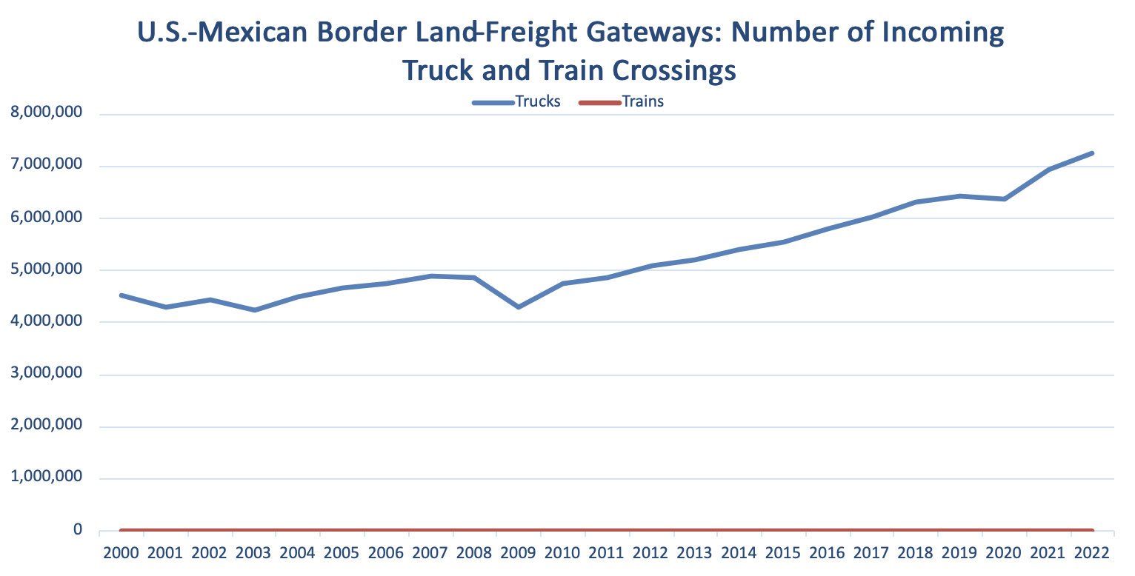
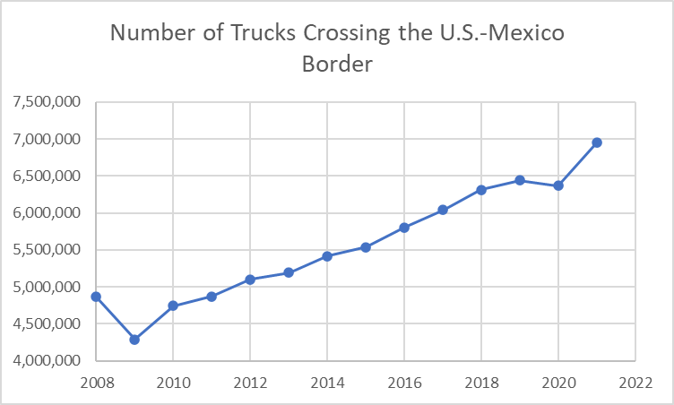
Trucks Crossing the U.S.-Mexico Border
Source: Bureau of Transportation Statistics, 2023
Notes:
https://www.bts.gov/browse-statistical-products-and-data/freight-facts-and-figures/number-incoming-trucks-trains-and

Slide 17
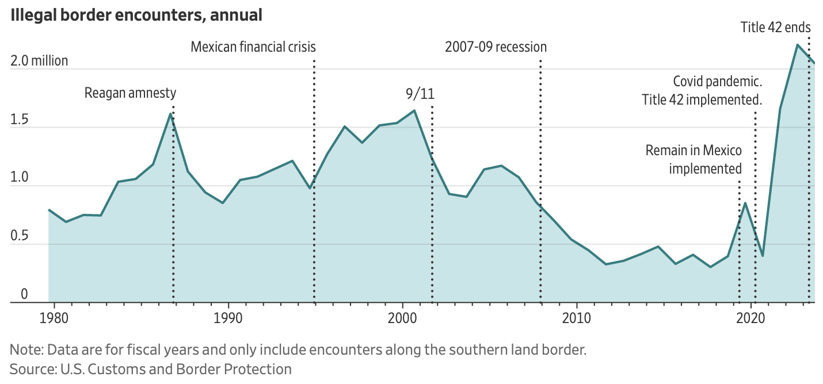
Illegal Border Encounters, Annual

Slide 18
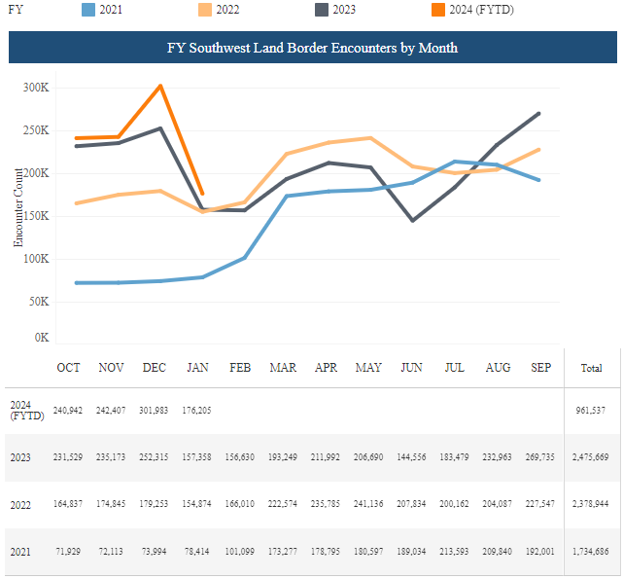
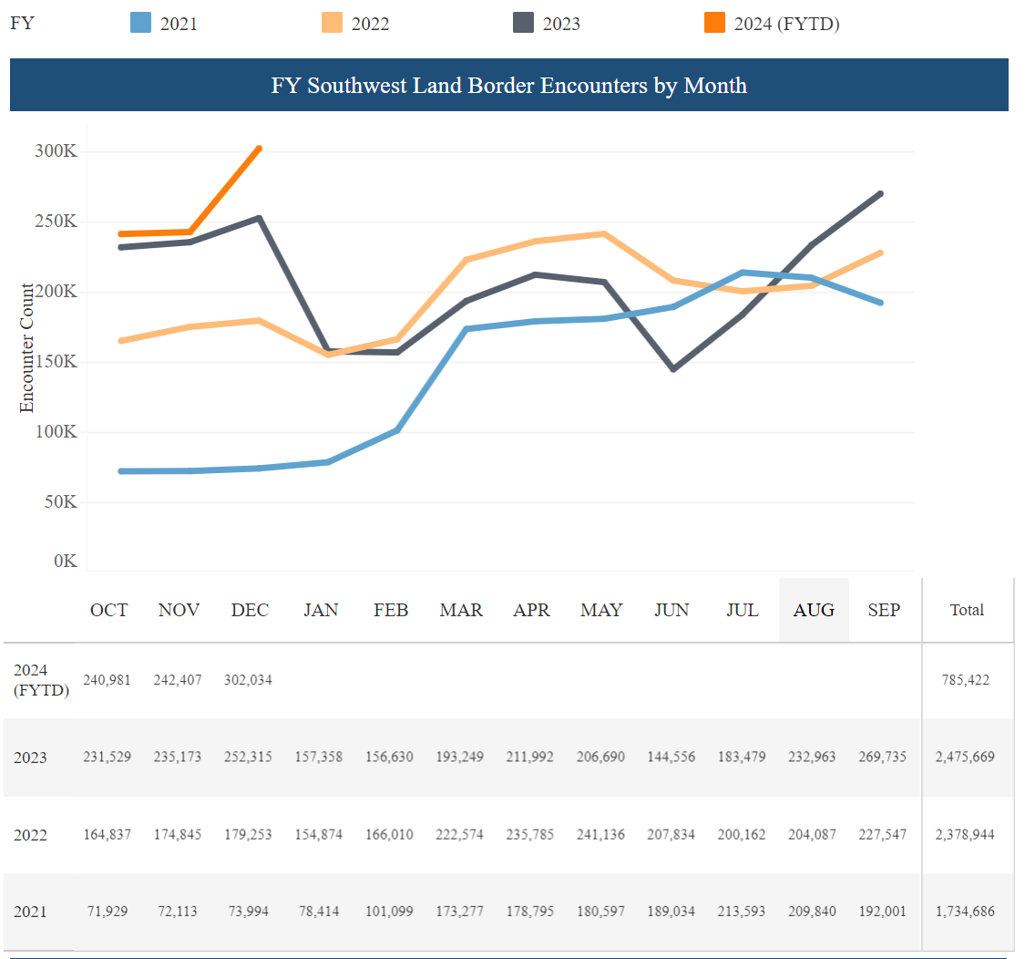
U.S.-Mexico border apprehensions FY 2021-2024(FYTD)
FY 2020, 458,088 apprehensions (COVID 19)
FY 2021, 1,734,686 apprehensions.
FY 2022 & 23, record "encounters": 2,378,900 in FY 22 & 2,475,000 in FY 23. Still high FY24.
More families, more adults, more Mexicans; many more from elsewhere (a record 51%).
Under Biden, over 6 million apprehended; some 4 million expelled; and 2.3 million released;
Est. 8 million migrants with temporary status entered during Biden Administration
Notes:
https://www.cbp.gov/newsroom/stats/sw-border-migration
The increase was driven in part by a dramatic spike in border apprehensions of family members at the end of last year.
http://www.pewresearch.org/fact-tank/2019/01/16/border-apprehensions-of-migrant-families-have-risen-substantially-so-far-in-2018/
Pew Research Center
https://www.nytimes.com/2019/03/05/us/border-crossing-increase.html
https://www.wsj.com/articles/u-s-border-crossings-continue-to-fall-as-mexico-disrupts-migrant-flow-11567646550?shareToken=stc6d175cd28984f8a9ab4cd4603a00366&reflink=article_email_share
https://www.pewresearch.org/fact-tank/2019/11/01/whats-happening-at-the-u-s-mexico-border-in-5-charts/
January figure: https://www.washingtonpost.com/immigration/us-mexico-border-crossings-continue-to-drop-but-mexican-migrants-surging/2020/02/11/fc797a4e-4cfb-11ea-b721-9f4cdc90bc1c_story.html
New chart: https://www.cbp.gov/newsroom/stats/southwest-land-border-encounters

Slide 19
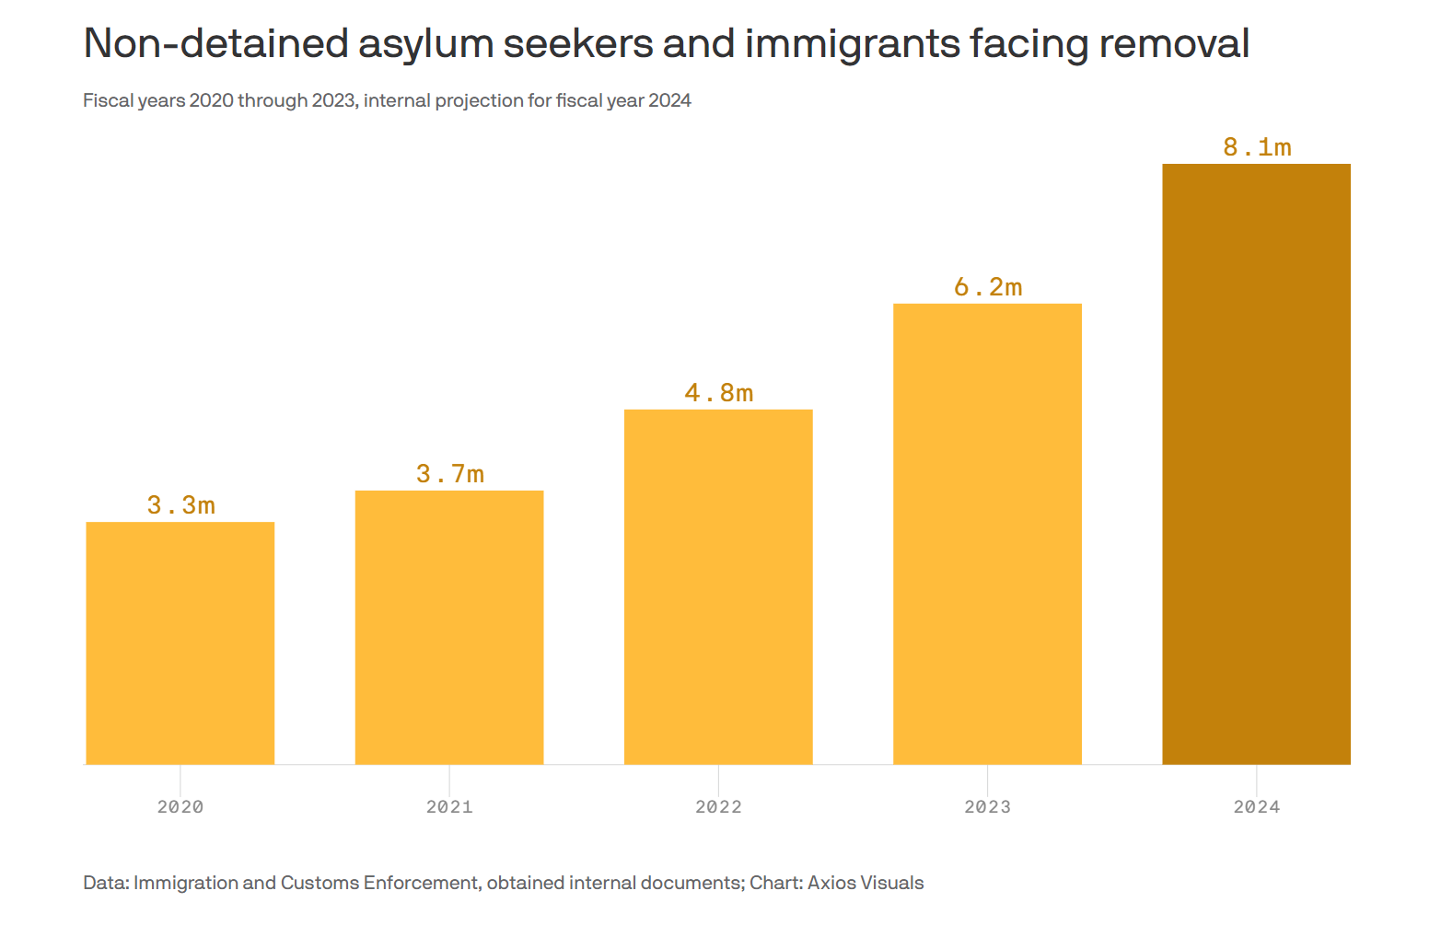
Asylum Seekers Pending Deportation

Slide 20
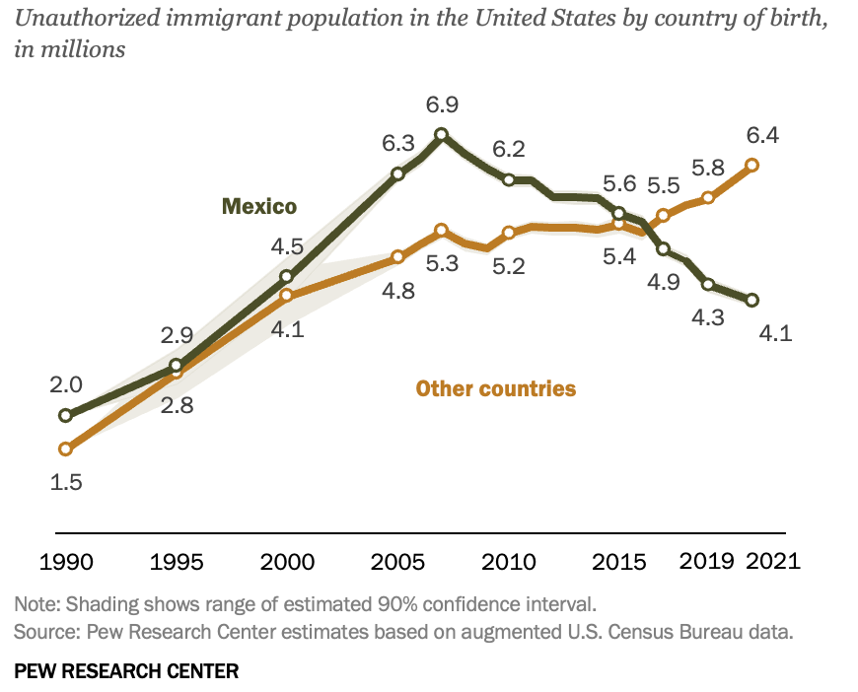
48% Unauthorized Immigrants are Mexican;10.7 mil Mexican-born in US;1 mil more than 2010.
Source: PEW Research Center, 2023
Notes:
Pew and Migration Policy do not have new information and I could not find any updated information elsewhere
https://www.pewresearch.org/fact-tank/2019/06/12/us-unauthorized-immigrant-population-2017/
Released by Pew on December 13, 2019.

Slide 21
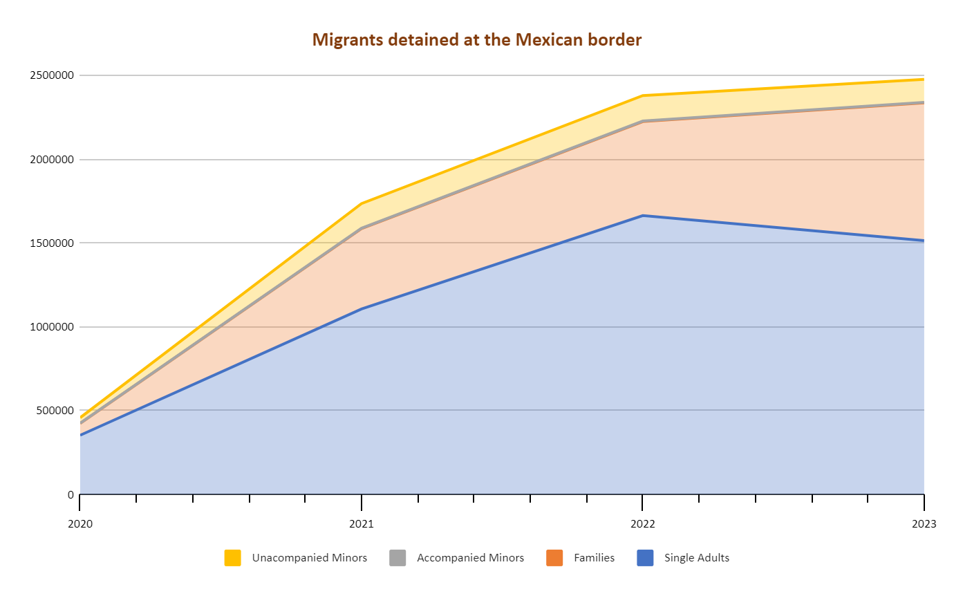
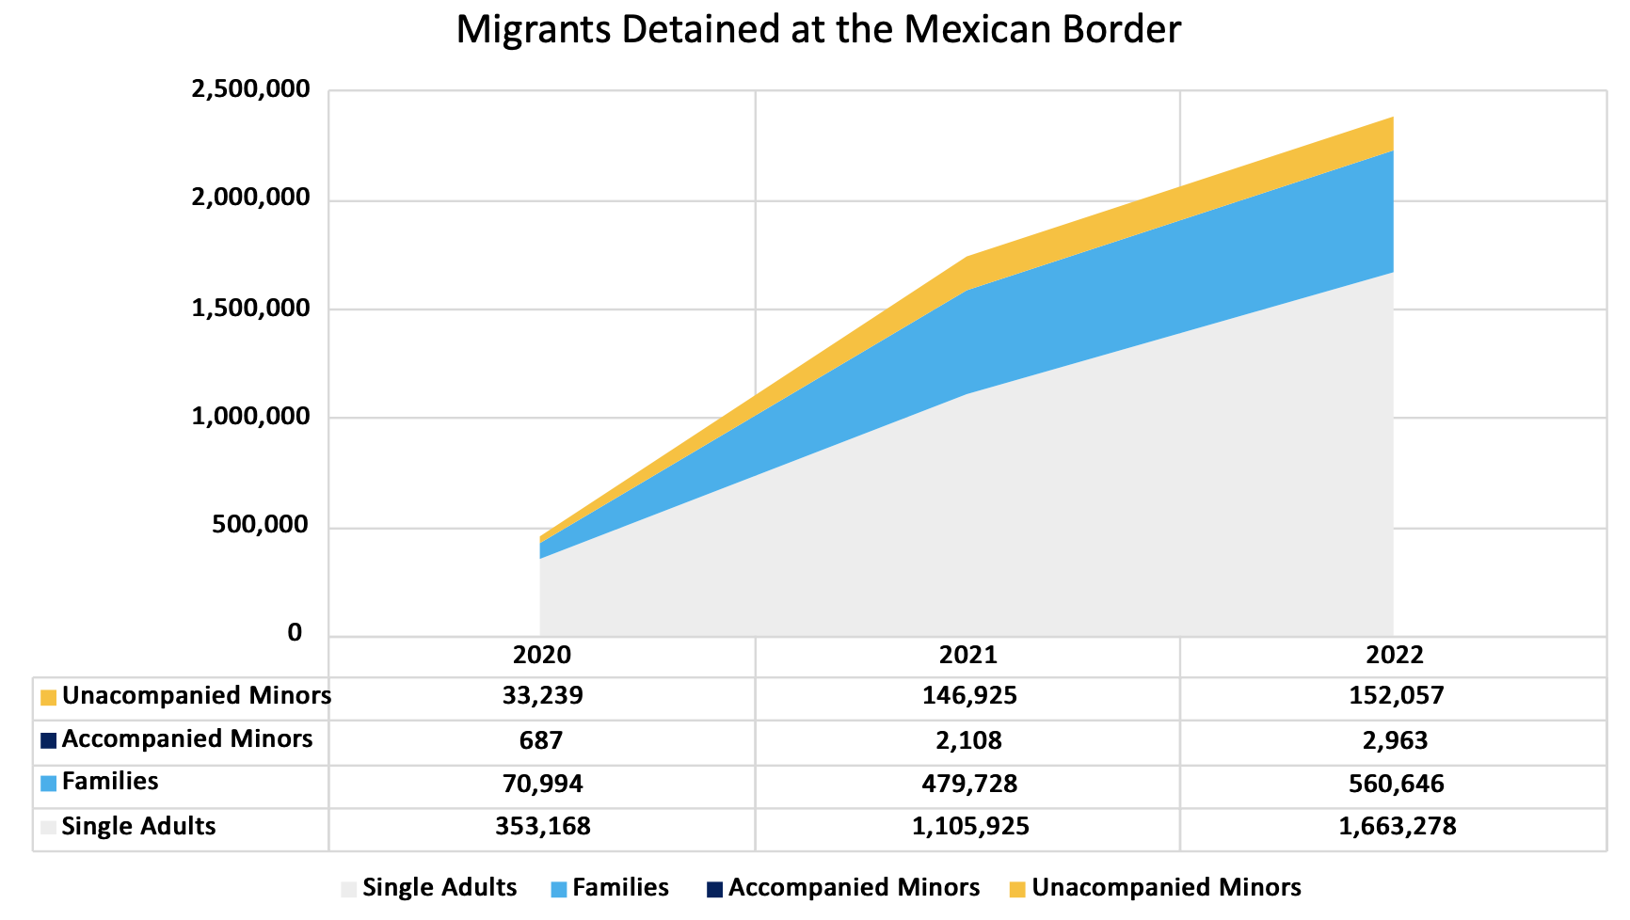
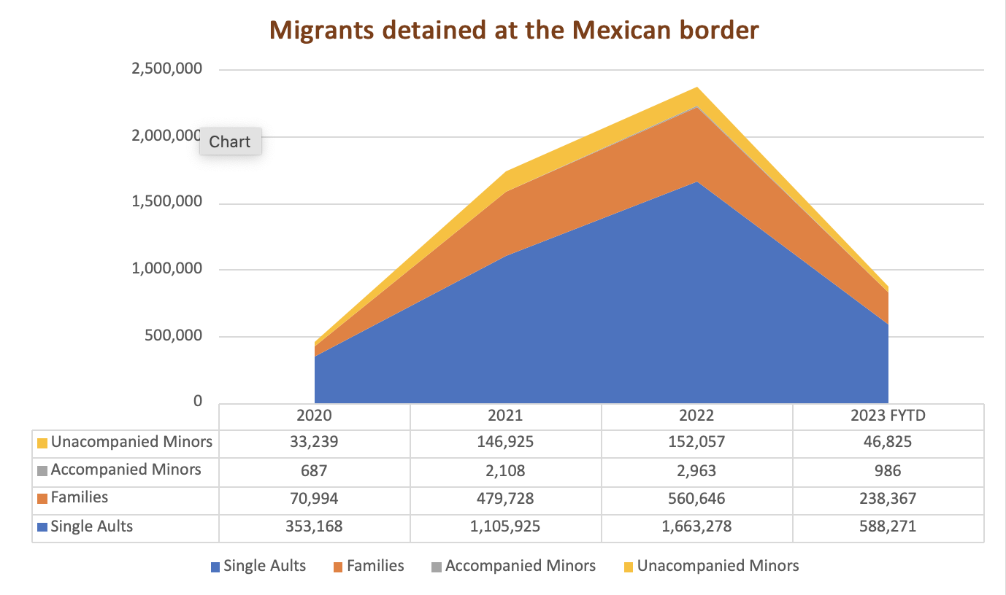
Migrants Detained at SW Border – through FY 2023

Slide 22
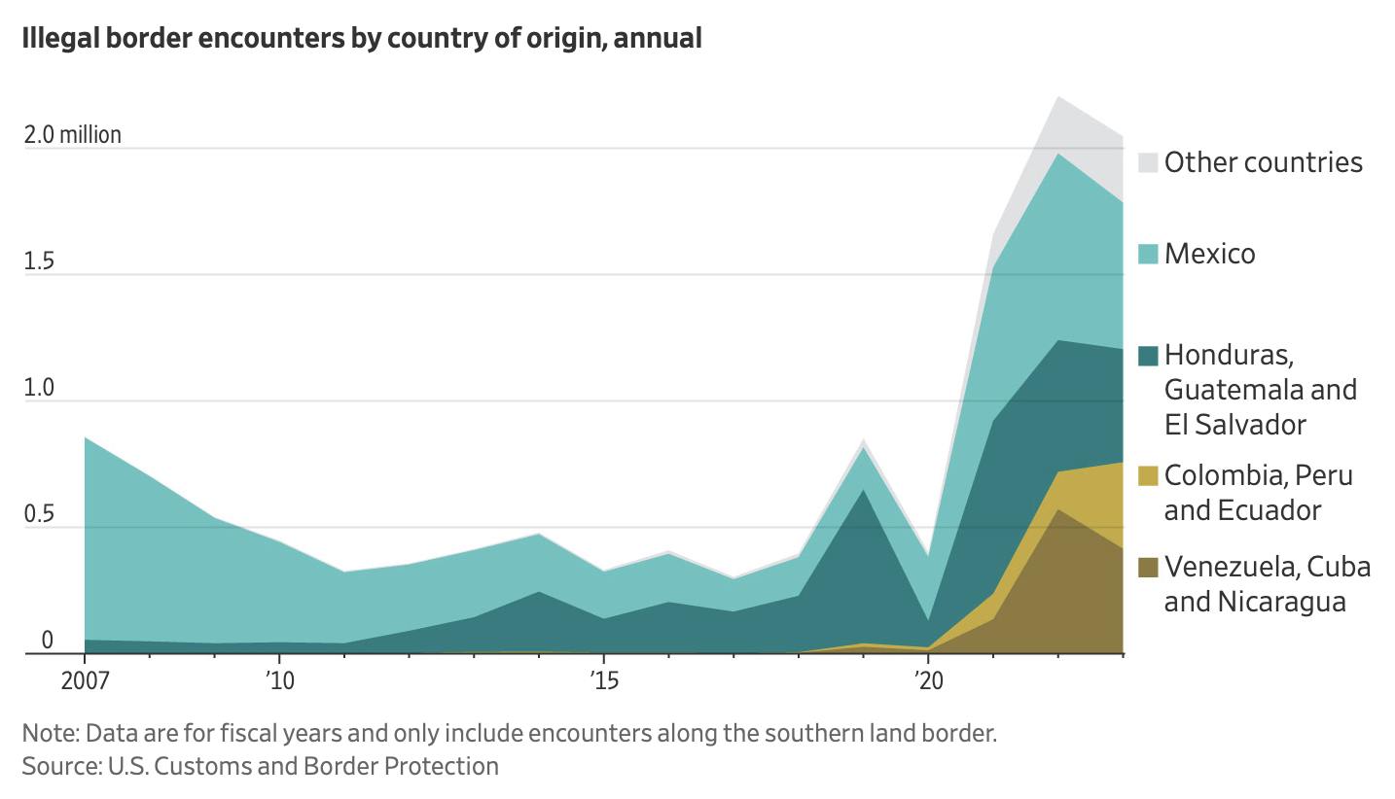
Illegal border encounters by country of origin, annual

Slide 23
Crime: Better Collaboration & Results?

Slide 24
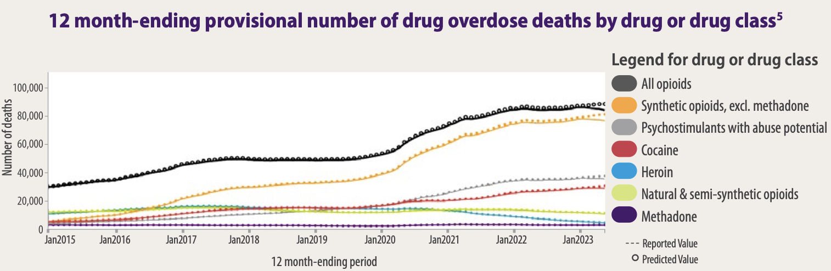
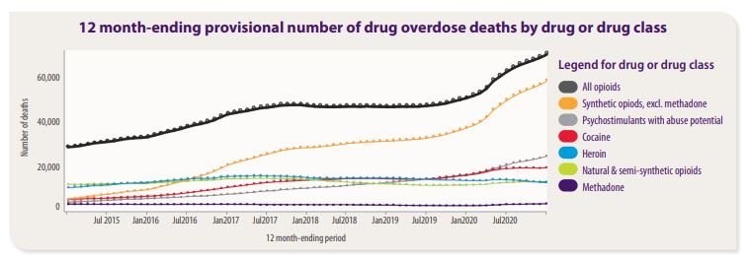
Driver: Drug Overdose Deaths over 109,000 in full year 2022
Synthetic Opioids = 75,000 deaths; Many saved by rapid treatment
Source: 2023 OVERDOSE EPIDEMIC
Notes:
https://www.drugabuse.gov/drug-topics/trends-statistics/overdose-death-rates
https://www.cdc.gov/nchs/nvss/vsrr/drug-overdose-data.htm
No updated graph for the multi-trend graph
https://www.drugabuse.gov/drug-topics/trends-statistics/overdose-death-rates

Slide 25
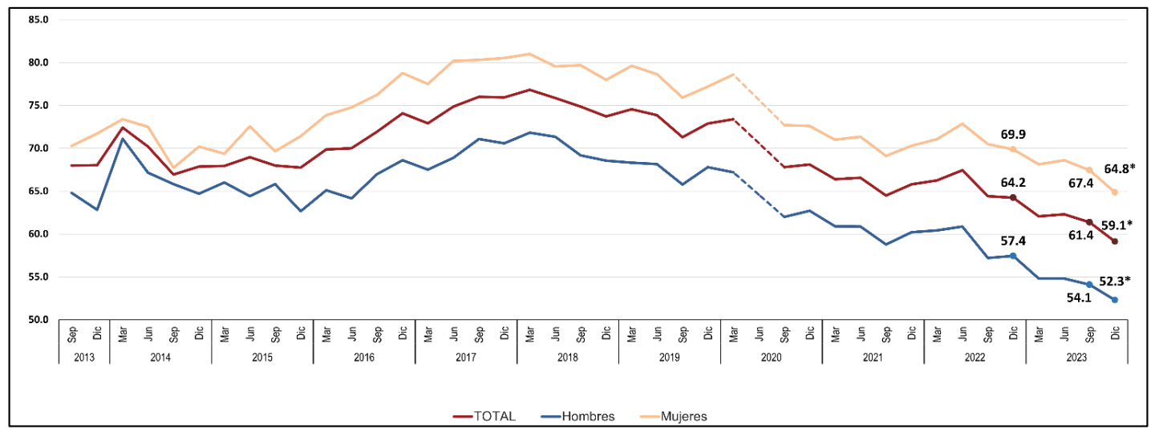
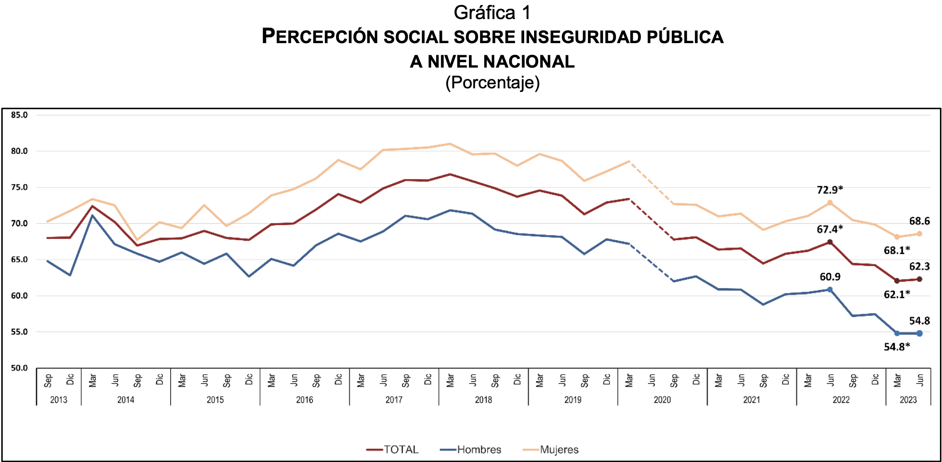
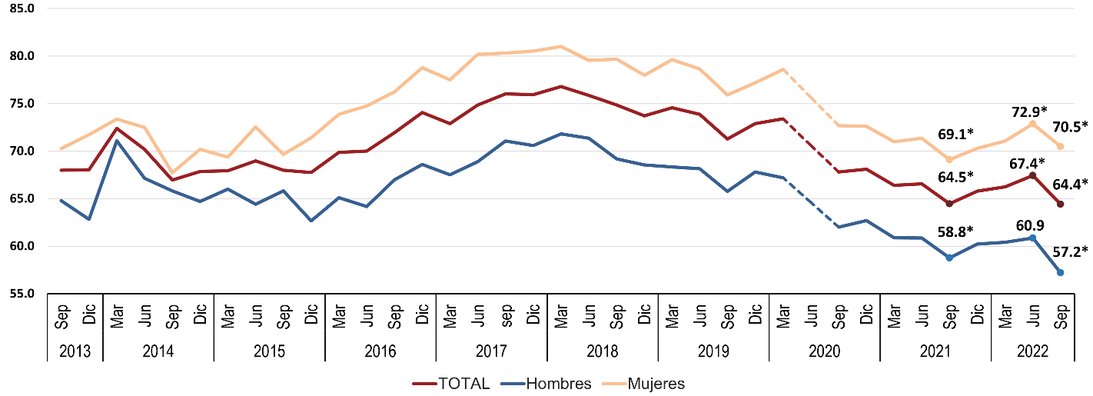
Perception of Public Insecurity
64.8% of Mexicans feel insecure in their cities
Social Perception of Public Insecurity at the National Level (Percentage)
Source: INEGI (2023)
Notes:
Source: INEGI (2022)

Slide 26
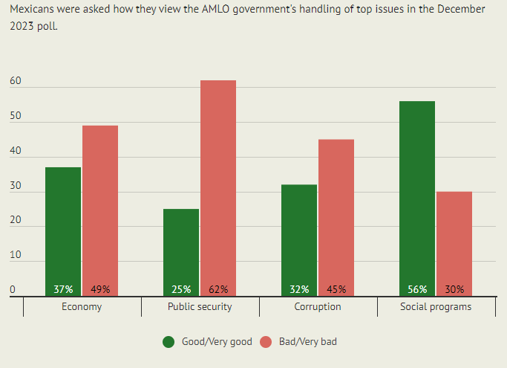
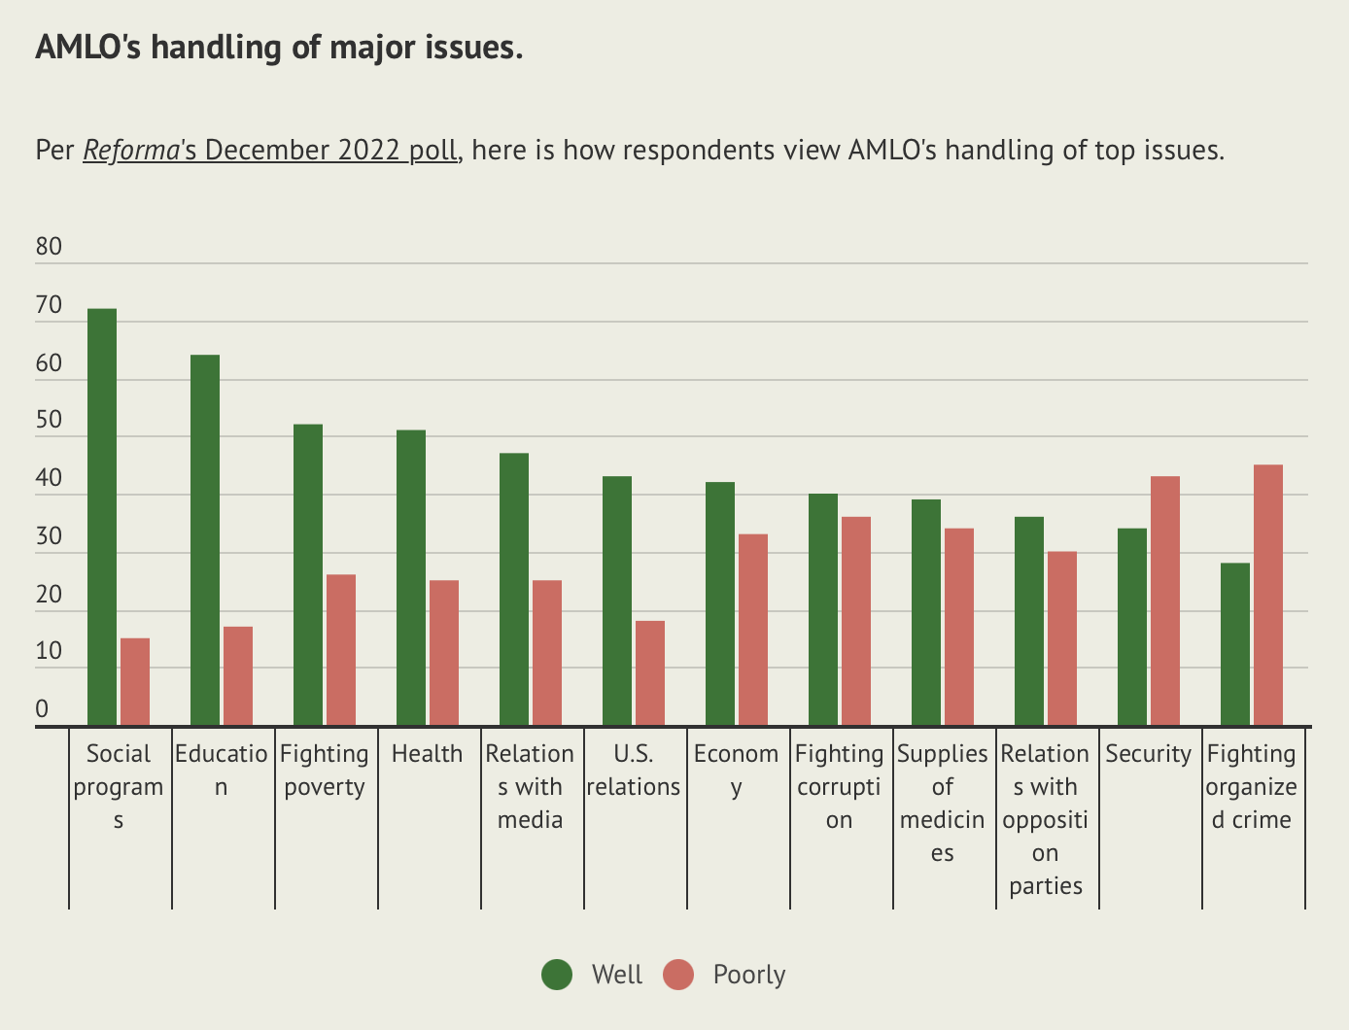
Perception: AMLO's Handling of Issues: Underwater on Security, Corruption and Economy

Slide 27
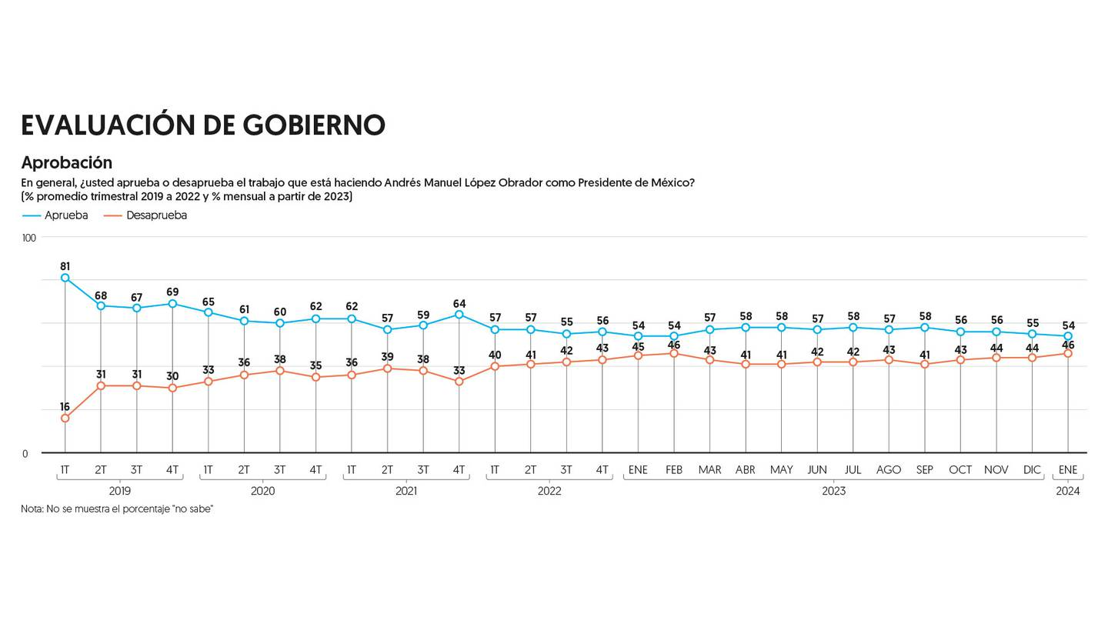
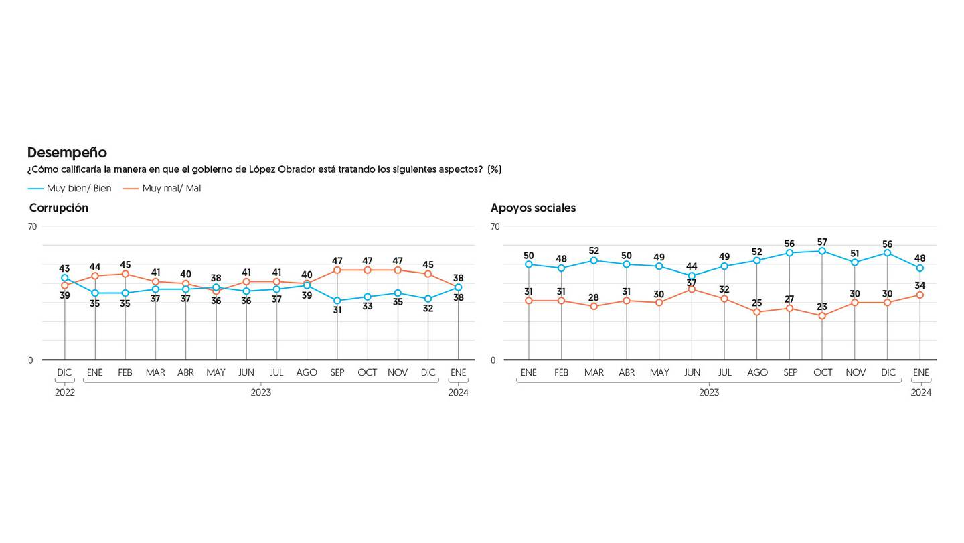
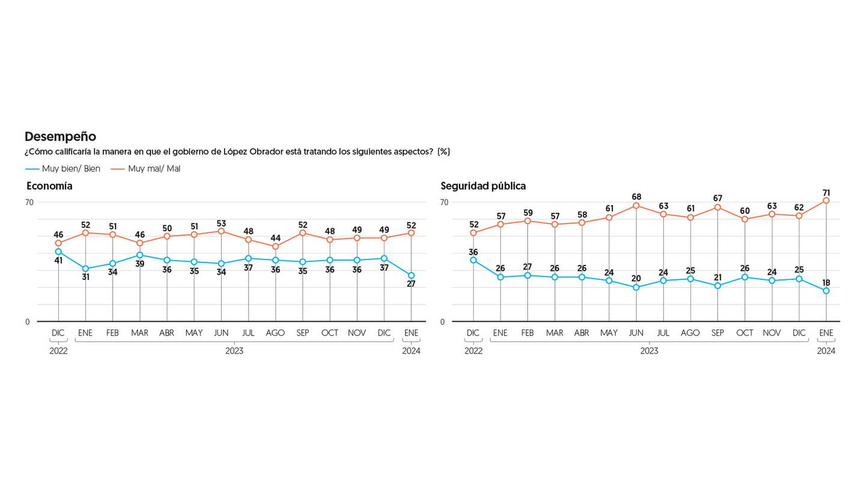
1/2024 poll: Approval of AMLO´s administration. Specific issues: corruption, social welfare, economy, and security
January 2024:
AMLO rated poorly on
security (71%),
economy (52%),
corruption (38%),
social welfare (48%)

Slide 28
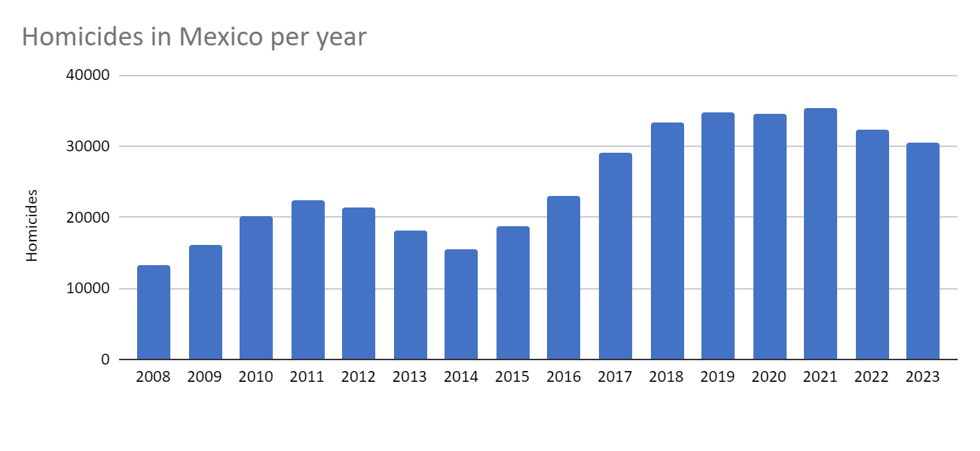
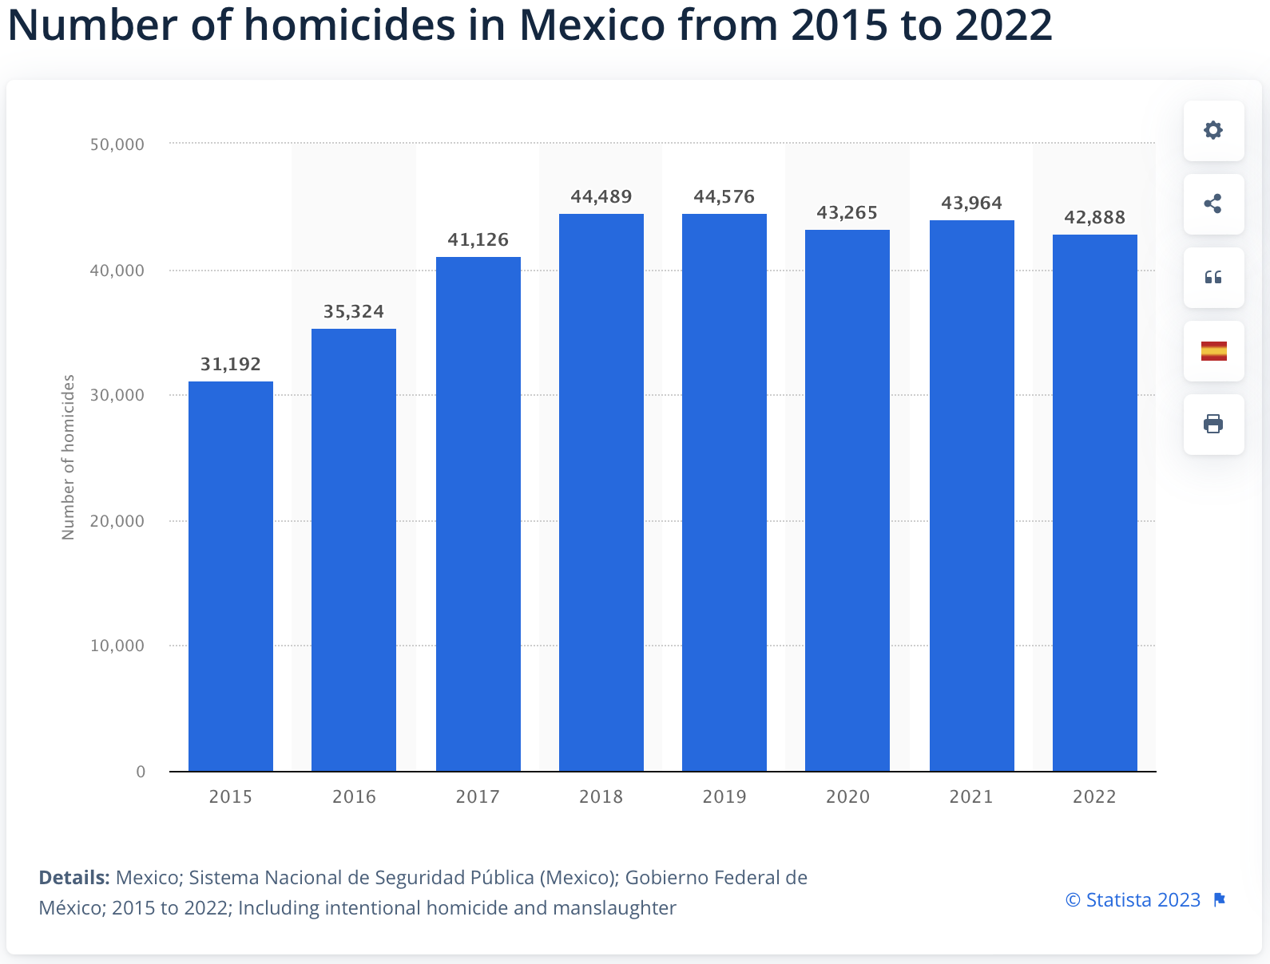
Homicides and Femicides: Still at Crisis Levels
2019 Record 34,648
2022 declined to 32,223
2023 declined to 30,523.
But during AMLO's term
over 170,000 – a record.
50% homicides in 6 states.
Violence cost Mexico 18.3% GDP in 2022, $230 billion.
40,000 missing under AMLO.
$19-30 billion drug profits.
US main source of crime guns.
http://www.informeseguridad.cns.gob.mx/
Notes:
http://www.informeseguridad.cns.gob.mx/ (first column also generates report as bottom link)
https://drive.google.com/file/d/1kq1RbdMNX8OIwD54DKBVI5QExmfS22Tt/view
“Select informe de incidencia delictiva del fuero común” 2022 Mexio Peace Index Report
https://www.gob.mx/sesnsp/acciones-y-programas/incidencia-delictiva-87005?idiom=es
https://www.gob.mx/sesnsp/acciones-y-programas/incidencia-delictiva-87005?idiom=es
http://www.informeseguridad.cns.gob.mx/
http://secretariadoejecutivo.gob.mx/docs/pdfs/victimas/Victimas2017_122017.pdf
http://secretariadoejecutivo.gob.mx/docs/pdfs/nueva-metodologia/CNSP-V%C3%ADctimas-2018.pdf
http://secretariadoejecutivo.gob.mx/docs/pdfs/victimas/Victimas2016_122016.pdf
2018 NUMBERS: http://secretariadoejecutivo.gob.mx/docs/pdfs/nueva-metodologia/CNSP-Delitos-2018.pdf
http://secretariadoejecutivo.gob.mx/docs/pdfs/nueva-metodologia/CNSP-V%C3%ADctimas-2018.pdf
3,100 murders for March 2019 – according to Hope – figures could be understimated https://mexiconewsdaily.com/news/homicide-figures-have-been-underestimated/
https://mexiconewsdaily.com/news/may-homicides-highest-in-9-months-numbers-are-steadily-rising/
http://www.informeseguridad.cns.gob.mx/files/homicidios_03062021_v2.pdf
https://www.gob.mx/sesnsp/acciones-y-programas/victimas-nueva-metodologia?state=published
https://drive.google.com/file/d/1OMTnSO_v3ljDGOuz0kG5s9Aeqw7vEIru/view
http://www.informeseguridad.cns.gob.mx/files/?C=M;O=D (monthly updates)

Slide 29
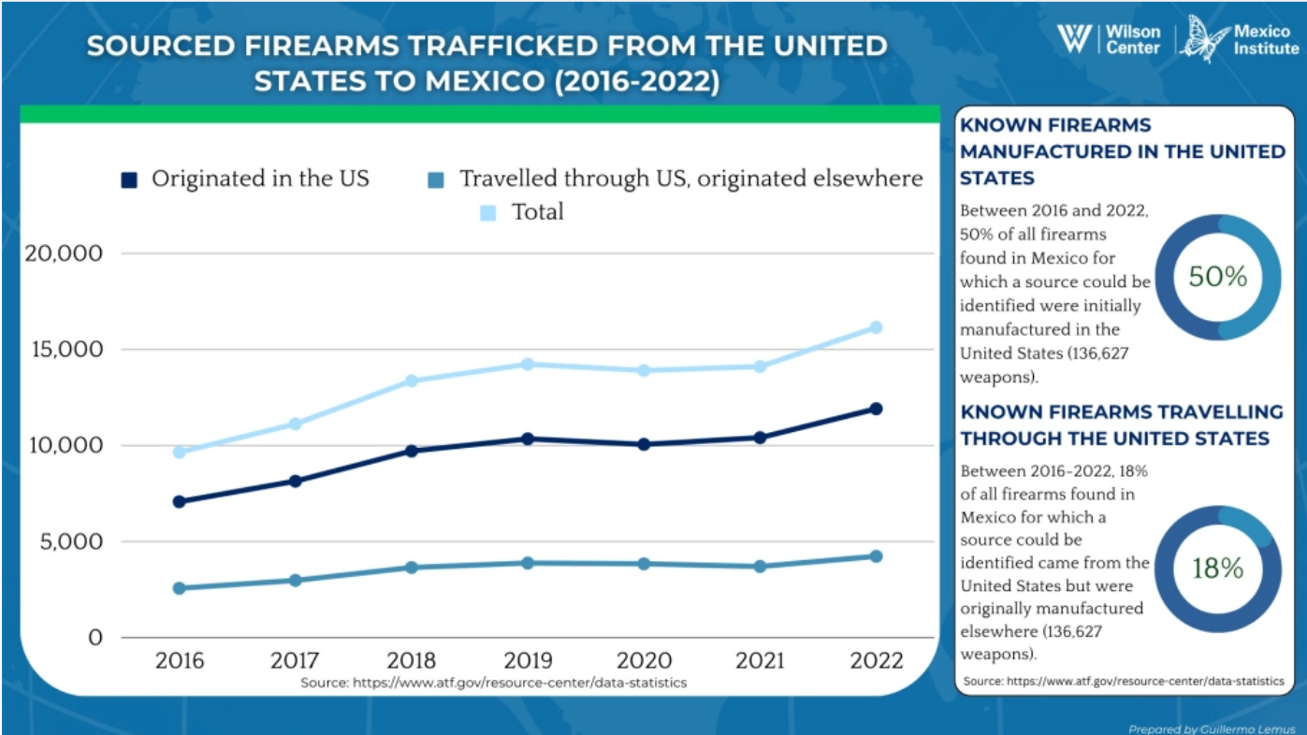
From 2016 to 2022, there was a 105% increase in rifles found in Mexico. Cartels may be favoring this type of firearm.
Specific US counties have been linked to weapons found across Mexican municipalities, spanning from the Pacific to the Atlantic Coasts.

Slide 30
Mérida Initiative: 2007-2022
U.S.-Mexico Merida Program Goals
Established 2007
Over $3.5 billion appropriated since 2008.
$1.6 billion already spent on training and equipment via over 100 programs to bolster Mexican capacity. Progress on some technical training.
Disrupting the operational capacity of organized crime.
Institutionalizing reforms to sustain the rule of law and respect for human rights in Mexico.
Creating a “21st Century Border”.
Building strong and resilient communities.
Mexico has spent over 10 times more, but heroin, fentanyl and meth trafficking still massive, violence still high impunity, and well over 90% impunity on most crimes.
Congress provided $155 million in FY 2019, $158 million in FY 20, $159 million in FY 21, $141 million in FY 22 request; FY 23 request: $114 million.
Total US aid 2001-23: $19.4 billion
Congressional Research Service, 2021, 22, 23
Notes:
https://fas.org/sgp/crs/row/IF10578.pdf

Slide 31
Law Enforcement & Security Cooperation: 2007-24
Mérida Initiative & Agency-to-Agency Cooperation (2007-21)
Defense Dialogues & Cooperation
Security Coordination Group (est. 2014)
High-Level Security Group (est. 2019)
Cabinet-Level Security Dialogue and Bicentennial framework (est. 2021)

Slide 32
Expert Suggestions for Cooperation (2018-2024)
An alignment of key security objectives.
Create a bilateral coordination group to reconcile the priorities of both nations (done).
Build cooperation with the National Guard and at sub-national levels (in process).
Training to improve Mexican law enforcement and criminal justice system (in process); launch joint investigative work, including on illicit finance (needed).
Establish/re-activate/strengthen international liaison units including at border to help with investigations, information-sharing, etc.; deepen prosecutor cooperation (underway).
Create a joint U.S-Mexico task force on countering fentanyl trafficking (underway).
Exchange best practices on drug abuse prevention & harm reduction strategies (started).
Enhance cooperation to strengthen local policing and justice in Mexico (some underway).
Enhance cooperation on migrant smuggling & Central America networks (in process).
Separate cannabis regulation from security cooperation (so far yes).
US-Mexico Cooperation Taskforce 2018-2024
Notes:
An alignment of key security objectives is essential.
Create a bilateral coordination group to reconcile the priorities of both nations.
Build cooperation with the National Guard and at sub-national levels.
Training to improve the Mexican criminal justice system; launch joint investigative work including on illicit finance; enhance the quality and capacity of Mexico’s law enforcement and justice operations.
Establish/re-activate international liaison units to help with investigations, information-sharing, evidence gathering, etc.
Create a joint U.S-Mexico task force on countering fentanyl trafficking.
Exchange best practices on drug abuse prevention and harm reduction strategies.
Enhance cooperation to strengthen local policing and justice approaches in Mexico.
Enhance cooperation on criminal groups working through and from Central America.
Separate cannabis regulation from security cooperation.

Slide 33
2017-2021 Growing Challenges on Illicit Drugs
2017 agreement to comprehensive strategy on supply and demand for illicit drugs. Attack entire criminal business network from means of production, cross-border distribution networks to profit flows and weapons procurement. Tools: physical barriers, technology, patrolling, eradication, enhanced cooperation, anti-addiction programs. Never Implemented.
In 2018, AMLO ordered a review, but did not agreed to update strategy until October 2021
U.S. concern grew. December 2019 U.S. citizen families massacred; US threat to designate cartels as Foreign Terrorist Organizations sparked progress, but opioids and meth continue massive flow northward, drug organizations flourish, US drug overdose deaths surge.
Former Defense Secretary’s arrest in late 2020 generated Mexican law sharply restricting anti-crime cooperation.
VP Harris June 2021 visit sparks launch in October of a High Level Security Dialogue & a new Bicentennial Framework. Problems in effective cooperation persist but stronger efforts 22-23.
Notes:
https://www.washingtonpost.com/opinions/2021/06/14/war-on-drugs-50-years-mexico-violence-calderon/
https://www.milenio.com/politica/elecciones-2021/rastrean-ligas-del-crimen-con-dos-gobernadores-electos
https://www.elfinanciero.com.mx/opinion/raymundo-riva-palacio/2021/06/14/el-narco-voto-por-morena/

Slide 34
New Start: High level Security Dialogue (HLSD)
US and Mexican cabinet members agreed to replace Merida with a new “Bicentennial Framework for Security, Public Health and Safe Communities” in October 2021.
Agreed to forge a more detailed action agenda by the end of 2021 and then a 3-year action plan.
  Investing in public health as related to the impacts of drug use, supporting safe communities, and reducing homicides and high-impact crimes.
  Reducing transborder crime by securing modes of travel and commerce, reducing arms trafficking, targeting illicit supply chains, human trafficking & smuggling.
  Pursuing criminal networks by disrupting illicit financiers and strengthening security and justice sectors.
26 joint objectives announced January 2022. HLSD met again in 2022 & 23. Agreed much work still to do: Fentanyl, Arms, Migrant Smuggling, Illicit Money. Of late, bi-monthly meetings.
Will require rebuilding trust and finding ways to successfully arrest and bring criminals to justice.
Notes:
https://www.whitehouse.gov/briefing-room/statements-releases/2021/10/04/u-s-mexico-high-level-security-dialogue/
https://mx.usembassy.gov/joint-statement-u-s-mexico-high-level-security-dialogue/

Slide 35
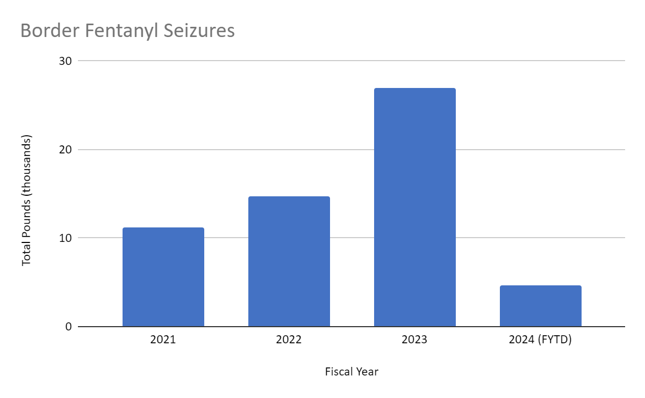
Fentanyl Seizures SW Border up 241% FY 2021-23 despite High Level Security Dialogue
Fiscal Year | Total (Pounds)
2021 | 11.2K
2022 | 14.7K
2023 | 27.0K
2024 (FYTD) | 4.6K

Slide 36

Persistent Challenges: need trust and results
“Chronic irritants” to bilateral security cooperation continue. Foreign Terrorist Designation or Military Stikes won't solve the problems.
  Corruption & mistrust persist (better vetting).
  Weak Mex. enforcement & justice systems.
  Human rights violations continue.
  Weapons trafficking southward.
  Illicit money flows to Mexico.
  Need top-level political commitment; whole of government strategies.

Slide 37
Trade, Investment, and Competitiveness:
NAFTA to USMCA and Beyond

Slide 38
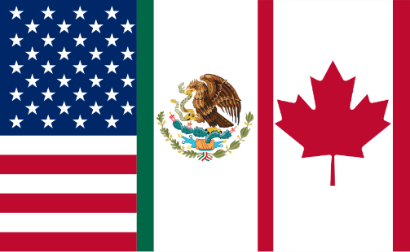

North American Trade
Canada, Mexico and the U.S. trade $1.57 trillion a year.
$4.3 billion a day, reflecting shared production networks.
More than US trade with all the European Union and over 2 times more than with China.
Up to 11-12 million U.S. jobs are supported by trade and investment with both neighbors.
Some 50 percent of North American trade is intermediate goods.
Nearshoring and reshoring investment growing significantly.
US public investments and tariffs on China making a difference.
Source: Trade Partnership, 2019; Secretaria de Economia, 2017; BEA, 2017; Census Bureau, 2024, Brookings Metropolitan Policy program, 2017.
Notes:
https://piie.com/blogs/trade-investment-policy-watch/why-renegotiating-nafta-could-disrupt-supply-chains
https://www.brookings.edu/blog/the-avenue/2017/03/30/how-u-s-states-rely-on-the-nafta-supply-chain/
https://s3.amazonaws.com/brt.org/Trade_and_American_Jobs_2019.pdf

Slide 39
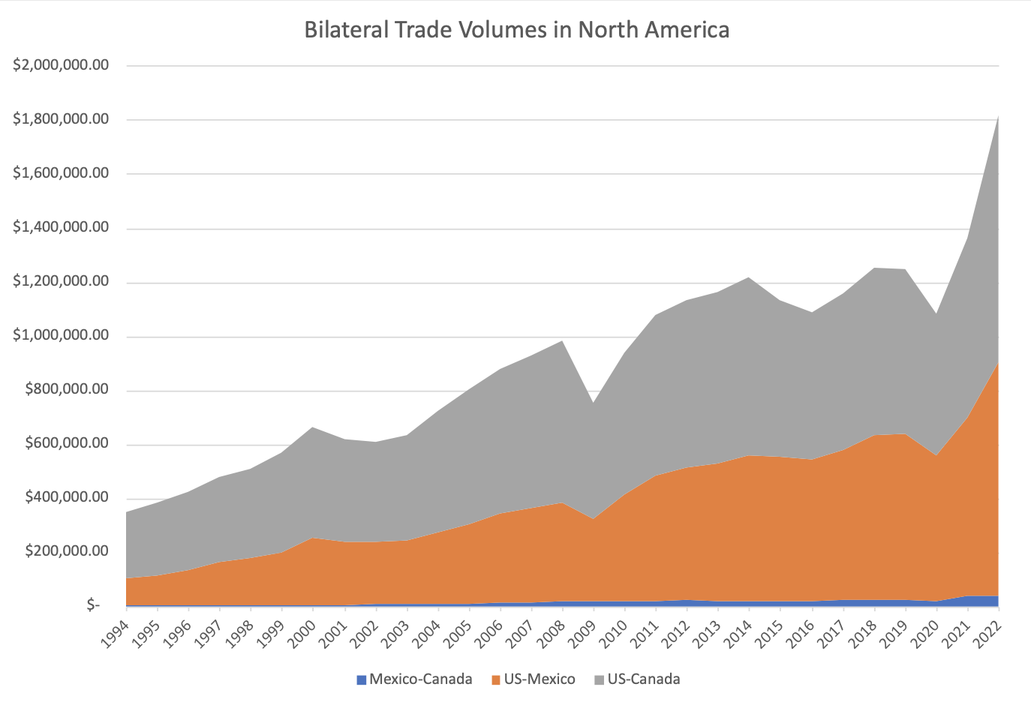
North American Goods & Services Trade: Over $1.6 trillion
Trade grown over 4 times since NAFTA launched
4 times larger since 1994
Source: Secretaria de Economia, 2018; BEA, 2018; Census Bureau, 2018; Americas Society/Council of the Americas, 2019, USTR 2020
Notes:
https://www.gob.mx/cms/uploads/attachment/file/244415/Anual-Exporta.pdf
https://www.gob.mx/cms/uploads/attachment/file/244416/Anual-Importa.pdf
https://ustr.gov/countries-regions/americas/Mexico
https://ustr.gov/countries-regions/americas/Canada
https://www150.statcan.gc.ca/n1/pub/13-609-x/13-609-x2018003-eng.htm
Updated: https://www.as-coa.org/articles/north-american-trade-numbers

Slide 40
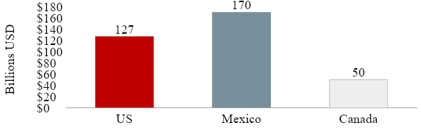
NAFTA Countries were richer each year due to “extra” trade growth (2014 estimate)
The pure economic payoff for the U.S. estimated at $400 per person
Source: NAFTA 20 Years Later. Petersen Institute for International Economics, 2014

Slide 41
Rank Order: Top U.S. States’ Exports To Mexico 2023
State | Volume $USD (Billions) | State | Volume $USD (Billions)
Texas | 129.5 | Oregon | 6.5
California | 33.2 | Tennesse | 6.1
Michigan | 14.5 | Pennsylvania | 5.4
Illinois | 12.9 | North Carolina | 5.4
Ohio | 8.2 | Georgia | 4.8
Arizona | 8.0 | Wisconsin | 4.3
Indiana | 7.5 | Florida | 4.2
Lousiana | 6.9 | Missouri | 3.8
Source: ustrade.census data, 2024

Slide 42
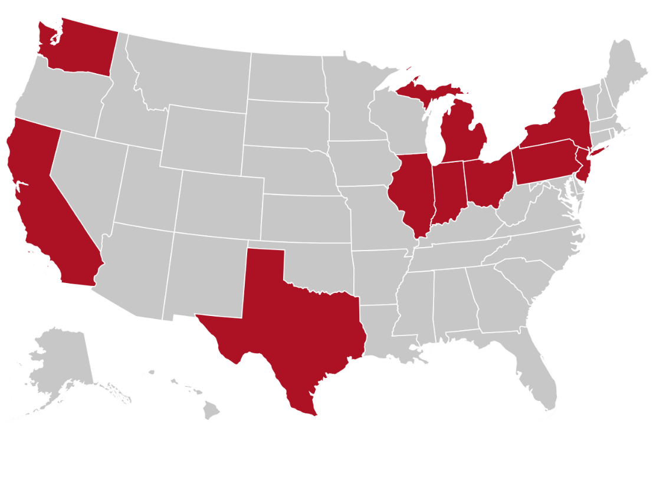
Top U.S. States’ Trade with Canada 2023
Canada ranks as the United States' top export partner, accounting for more than 18% of the total.
Canada is the number one export market for 35 U.S. states, and the largest foreign supplier of oil, natural gas, and electricity to U.S.
Top 10 Trading States
State | $USD (Billions) | State | $USD (Billions)
1. Texas | 35.8 | 6. California | 19.0
2. Michigan | 27.4 | 7. Indiana | 14.9
3. Ohio | 21.4 | 8. Washington | 9.5
4. Illinois | 20.5 | 9. Kentucky | 9.1
5. New York | 19.5 | 10. Tennessee | 8.8
Source: ustrade.census data, 2024
Notes:
https://www.forbes.com/sites/kenroberts/2017/07/11/37-u-s-states-count-canada-as-1-export-market-as-trudeau-speaks-to-governors/#17401b7b4e04
U.S. Census Bureau: https://www.visualcapitalist.com/closely-state-economy-tied-canada/

Slide 43
Net 12 million U.S. Jobs Related to Trade with Mexico & Canada
Top 10 states below
Trade with Mexico: 4.9 million
No. | State | Net Number of U.S. Jobs
1 | California | + 572.2
2 | Texas | + 399.5
3 | New York | + 325.5
4 | Illinois | + 198.0
5 | Pennsylvania | + 195.7
6 | Ohio | + 170.9
7 | Georgia | + 158.2
8 | North Carolina | + 150.6
9 | New Jersey | + 141.2
10 | Virginia | + 135.3
Trade with Canada: 7.2 million
No. | State | Net Number of U.S. Jobs
1 | California | + 898.5
2 | Texas | + 549.4
3 | New York | + 475.9
4 | Florida | + 446.3
5 | Illinois | + 293.7
6 | Pennsylvania | + 282.3
7 | Ohio | + 257.5
8 | Georgia | + 229.2
9 | North Carolina | + 225.8
10 | Michigan | + 209.7
Source: Trade Partnership, 2019

Slide 44

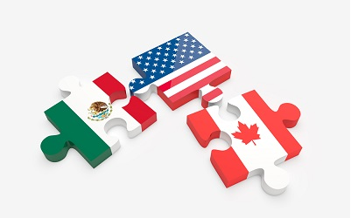
NAFTA to USMCA (T-MEC, CUSMA)
The USMCA (United States-Mexico-Canada Agreement), or T-MEC in Mexico, replacing the 1993 NAFTA (North American Free Trade Agreement).
New agreement signed on November 30, 2018.
A revised agreement reached on December 10, 2019.
U.S. Senate approved and President Trump signed USMCA in January 2020.
USMCA entered into force July 1, 2020. Implementation underway.
Source: Office of the United States Trade Representative, 2018.
Notes:
https://bmotreasuryinsights.com/nafta-2-0-how-do-you-spell-relief-usmca/
https://ustr.gov/trade-agreements/free-trade-agreements/united-states-mexico-canada-agreement/agreement-between

Slide 45
Main elements of the USMCA (T-MEC)
Rules of Origin, wages and steel for Vehicles to be phased in 2020-2023
  75% of the value of a vehicle to be produced in the region (up from 62.5%); 70% of steel and aluminum.
  40%-45% of auto content produced by workers earning over $16 per hour.
Dispute Settlement
  Maintains NAFTA’s dispute-settlement provision over unfair trade practice allegations (Chapter 19) and state to state differences of treaty interpretation (Ch. 20), but limits investor dispute (ISDR) options to key sectors of U.S.-Mexico investment; eliminates coverage for U.S.-Canada issues. New “rapid” dispute settlement for labor enforcement. Eliminated ability of a government to block a dispute settlement panel.
Updated Treatment of Intellectual Property Rights, Digital Trade issues, Labor, Environment…
  Achieved or exceeded most of modernization goals sought, including stronger labor rights provisions, IPR protections, includes ecommerce & data issues, anti-corruption, competitiveness, SMEs, among others.
Sunset Clause: 16-year lifetime for the agreement; review every six years; possible 16-year renewal.
Agriculture: Seeks to address concerns over Canada’s dairy policies; biotech & food safety.
Notes:
USTR Fact Sheet – Chris Email
https://www.reuters.com/article/us-trade-nafta-factbox/factbox-five-key-takeaways-from-trumps-u-s-mexico-trade-deal-idUSKCN1LC27K

Slide 46
Implementing USMCA
Governments agreed on procedures to monitor compliance, set up the dispute settlement systems, new committees to work through problems and build cooperation, and much more.
Post-Pandemic: Supply chains & border crossings disrupted; need to build resilient supply chains & smarter, modern borders to support trade. Takes govt-to-govt and private sector collaboration.
USMCA Concerns:
Mexico: Building Labor rights. Violating provisions on energy investments and regulations. Not honoring regulatory commitments on agriculture biotech (corn).
United States: Respecting vehicle rules of origin commitments; lost disputed panel.
Canada: honoring dairy commitments and data rules; Canada complaints re softwood lumber.
Biggest gain: reduced uncertainty. Need good implementation & enforcement, work on competitiveness; SMEs; digital trade, etc. The three countries will review results in 2026.
Notes:
https://adnpolitico.com/congreso/2018/10/01/los-lideres-del-senado-preven-que-el-usmca-pasara-sin-raspones
https://adnpolitico.com/congreso/2018/09/29/esta-es-la-ruta-del-senado-para-aprobar-el-acuerdo-de-renegociacion-del-tlcan
The Mexican Congress failed to meet a Jan. 1 deadline to pass legislation to establish labor reforms called for in the U.S.-Mexico-Canada Agreement, with a bill introduced last month in the Chamber of Deputies unlikely to be addressed until February.
https://insidetrade.com/daily-news/mexico-misses-usmca-deadline-labor-reforms-bill-could-be-taken-february

Slide 47
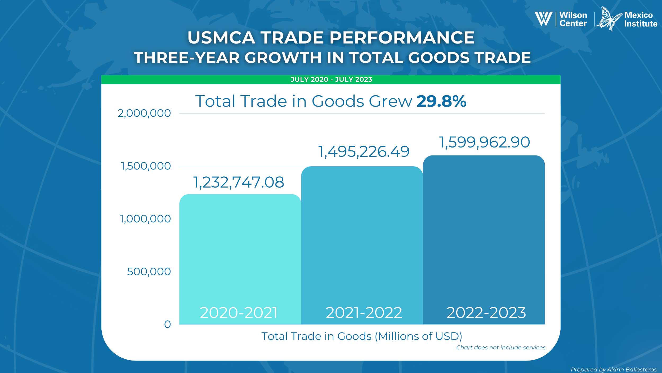

Slide 48
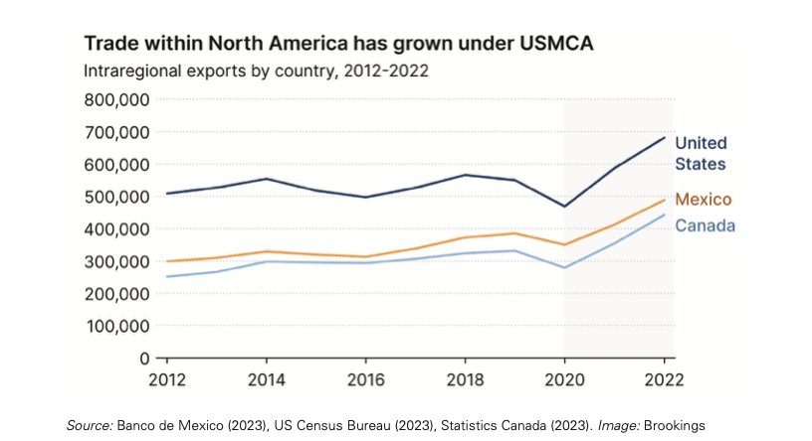

Slide 49
New: High Level Economic Dialogue (HLED)
Revived the US-Mexico HLED set up in 2013 to advance strategic economic and commercial priorities for both countries; Trump Administration abandoned.
In September 2021, cabinet ministers launched. Complementary to USMCA. Four Pillars:
a) “Building back together”: encourage resilient and reliable supply chains; renew border modernization to better manage and promote efficient trade flows.
b) “Promoting sustainable economic and social development in Southern Mexico and Central America”: identify best mix of programs and tools to get results.
c) “Securing tools for future prosperity”: promote collaboration on cross border information and technology systems, including cybersecurity policy.
d) “Investing in our people”: Look at ways to encourage workforce development including among disadvantaged populations.
Senior meetings 2023 reported work underway but few clear achievements.
Notes:
https://pulsenewsmexico.com/2021/09/20/us-and-mexico-strive-to-strengthen-ties/
https://www.thedialogue.org/analysis/what-will-the-u-s-mexico-economic-talks-accomplish/

Slide 50
Vitalizing the North American Leaders Summit (NALS): competitiveness, health and ...
Nov 2021 & Jan 2023, the North American Leaders Summit ambitious agenda (29 items):
Next Summit postponed; Needed to review and share results to date.
1. Competitiveness:
Create ministerial working group to attract nearshoring and resilient supply chains;
Hold trilateral forum with private sector on semiconductors (May 22);
Map semiconductor needs and opportunities;
Expand critical mineral mapping;
Expand student mobility;
Convene experts on building workforce skills in key sectors (over 5 years).
2. Health:
Strengthen North American plan to respond to health crises (NAPAPI).

Slide 51
North American Leaders Summit Agenda, part II:
Environment, Democracy, Migration, Security
Environment and Climate:
Forge strategy to reduce methane emissions in solid waste and wastewater;
Cooperate to achieve Global Methane pledge; Develop a food loss and waste reduction action plan;
Collaborate on bus best practices;
Develop plan to install EV chargers along international borders;
Trilateral cooperation to conserve 30% of world’s land and ocean by 2030;
Work to develop a North American clean hydrogen market.
Diverse, Inclusive, equitable, democratic societies:
  Trilateral exchange on equity & justice, violence against indigenous women, girls & LGBTQI+
  Declaration on Equity and Racial Justice.
Migration and Security:
Work to achieve safe, orderly, humane migration; cites several specific steps.
North American Drug Dialogue Principles met, held Public Health Summit,
Collaboration against trafficking in arms & drugs and chemical precursor diversion.
Collaborate on Nuclear Security and Safety; increased sharing cyber security best practices
Resume North American strategy to combat human trafficking.

Slide 52



North American Investment
In 2022, Canada’s FDI in the U.S. reached: $809 billion (52% of Canada´s investment abroad)
In 2022 Mexico’s FDI in the U.S. reached: $97 billion (50%)
The U.S. had $569 billion FDI in Canada and Mexico (9%)
US FDI in Canada
$438 billion
Mexico’s FDI in Canada
$871 million
$
Mexico’s FDI in the US
$97 billion
Canada’s FDI in the US
$809 billion
US FDI in Mexico
$130 billion
Canada’s FDI in Mexico
$26 billion
Sources: OECD Stat Database (2023); OECD Data, inward FDI stocks by partner country (2023).
Notes:
https://www.bea.gov/iTable/iTable.cfm?ReqID=2&step=1#reqid=2&step=10&isuri=1&202=1&203=22&204=10&205=1,2&200=2&201=1&207=55&208=2&209=25
Canada: https://ustr.gov/countries-regions/americas/Canada
Mexico: https://ustr.gov/countries-regions/americas/mexico
Canada FDI in US and Mexico: https://www.international.gc.ca/economist-economiste/statistics-statistiques/outward_inward-actifs_passif.aspx?lang=eng
Canada FDI in Mexico: https://www.statista.com/statistics/1017600/fdi-canada-mexico/
Mexico FDI in Canada: https://www.ceicdata.com/en/mexico/foreign-direct-investments-by-country/foreign-direct-investment-canada

Slide 53
Elections & AMLO’s Policies/Performance

Slide 54
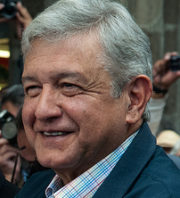
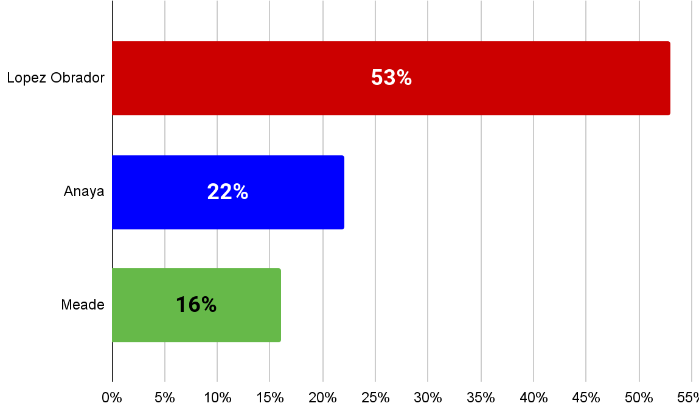
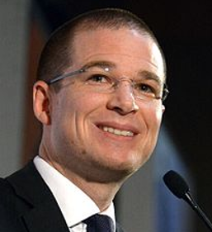

Presidential Results: Launches the “4th Transformation”
July 2018 voter turnout: 63.5%
AMLO won 53% of vote. (PAN 22%; PRI 16%)
Andres Manual Lopez Obrador’s party, Morena, won big majorities in Congress.
AMLO took office December 1.
Most powerful President in decades: few counterweights.
Source: Instituto Nacional Electoral; Consulta Mitofsky, 2018

Slide 55
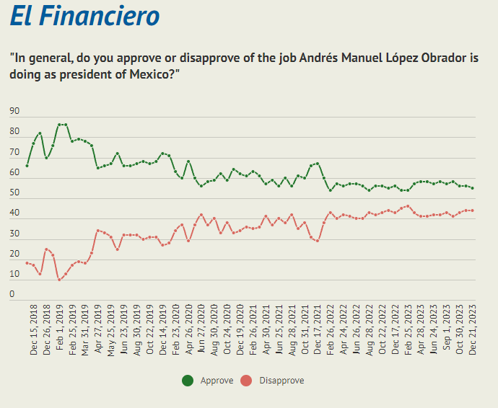


AMLO APPROVAL 2018-23 El Financiero poll. February results:
54% approve, 46% disapprove; Poor on security (59%), econ (51%)
Notes:
https://www.as-coa.org/articles/approval-tracker-mexicos-president-amlo

Slide 56





Presidential Candidates: March 2024 Sheinbaum/Morena 60% vs Galvez/Opposition 34% (Oraculus)
Notes:
Party Identification Graph (Buendía y Márquez): https://www.as-coa.org/articles/approval-tracker-mexicos-president-amlo

Slide 57



AMLO's Policies: Fourth Transformation
Economic Policy: Reducing Inequality while growing economy Focus on developing Mexico’s internal market; encourage investment. Build Infrastructure (e.g. railway, airport, oil refinery). Redirect spending to the poor but won’t raise taxes or increase debt. Lower taxes along U.S. border. Aim to achieve 4% average GDP growth over his six-year term; Develop south of country: Maya train, cross isthmus train. Expand Educational opportunities: apprenticeship programs and new universities. Energy: Strengthen Energy Independence and Public Sector role Strengthen national oil company, PEMEX, & electricity authority, CFE. Limit gasoline price increases; decrease prices in several years. Build new refineries. Slow/reverse previous energy reform allowing private sector role.
Source: Wilson Center’s Mexico Institute, 2018
Notes:
https://www.vox.com/2018/8/15/17690420/mexico-president-amlo-drug-war-cartels-violence-legalization
https://www.wsj.com/articles/mexicos-lopez-obrador-to-halt-oil-auctions-two-yearssources-1534972665?shareToken=ste90fe56ccde04da8914eb77c545ff867&ref=article_email_share
https://www.eleconomista.com.mx/politica/Plan-de-seguridad-de-AMLO-dividira-al-pais-en-265-regiones-con-un-coordinador-20181017-0056.html

Slide 58


AMLO’s Goals and Early Actions
Reduce Poverty: Increased minimum wage. Launched youth jobs programs. Subsidize inputs for small farmers; New Programs to benefit indigenous. Provide universal health coverage starting with elderly.
Attack Corruption and Government Inefficiency: Better supervision of public spending; increase legal penalties for corruption. Cut officials’ salaries. Reduce staff. Slash existing programs. Name independent “Fiscal General”; active Financial Crime Unit. Promised to pursue corruption investigations. Use direct means to consult “the people.”
Source: Wilson Center’s Mexico Institute, 2018
Notes:
https://mexicoelectionsblog.weebly.com/education.html
https://lopezobrador.org.mx/2018/07/15/50-lineamientos-generales-para-el-combate-a-la-corrupcion-y-la-aplicacion-de-una-politica-de-austeridad-republicana/

Slide 59


Security Proposals and Goals – few met
Security Proposals: End to the War on drugs - hugs not bullets. Consider reforms on drug production and use. Social, education and jobs programs to weaken crime’s attraction. Provide alternatives to drug cultivation and fuel theft. Generate peace though non-violent methods. Emphasize human rights. Strengthen the judicial system. Expand National Guard across 226 regions. Goals shared publicly: reduce crime rate by 15%. reduce homicides and car theft by 50%. reduce the public perception of insecurity from 80% to 39.4%. boost World Justice Project’s Rule of Law score to 0.60 by 2024 (at .42, declining)
Notes:
https://www.vox.com/2018/8/15/17690420/mexico-president-amlo-drug-war-cartels-violence-legalization
https://www.wsj.com/articles/mexicos-lopez-obrador-to-halt-oil-auctions-two-yearssources-1534972665?shareToken=ste90fe56ccde04da8914eb77c545ff867&ref=article_email_share
https://www.eleconomista.com.mx/politica/Plan-de-seguridad-de-AMLO-dividira-al-pais-en-265-regiones-con-un-coordinador-20181017-0056.html

Slide 60
AMLO after 5+ years: Mixed Results
Popularity: consistently over 50%. Talented political communicator.
USMCA and US: trade was essential for Mexico to recover from pandemic; serious disputes need resolution.
Pandemic: Deaths were high, showed weak public health system; poverty rose.
Economy: Contraction 8.2% in 2020; rebounded 5% in 2021; 2022 3%; 2023 est. 3.4%. Many perceive negative business environment, but proximity of US market is sparking exports. Massive remittances from US help.
Poverty: By 2023, 5.7 million fewer Mexicans lived below the poverty line than in 2018 (56 million), but those in extreme poverty rose. 30 million more than in 2018 reported no access to health care. Still increased money to poorer workers/farmers.
Infrastructure Controversial: Dos Bocas refinery, Tren Maya over budget. Using expropriation to complete trans-isthmus railway (Tehuantepec). New Felipe Angeles airport under-used. AMLO claims success; Opposition says wasted money.
Notes:
https://www.wsj.com/articles/how-amlo-is-like-venezuelas-chavez-11612131759?st=b2b8d4rqivvb3tb&reflink=article_email_share
https://mexiconewsdaily.com/news/coronavirus/health-authorities-estimate-one-quarter-of-mexicans-have-been-infected-with-covid/
https://www.controlrisks.com/-/media/corporate/files/campaigns/ccc/ccc_2021_report_english.pdf

Slide 61
AMLO after three plus years: Results, part II
Crime: homicide, crime & violence historically high. Homicide rate improving. 2022 Homicide rate 62% higher than in 2015 and organized crime rate highest recorded. Border Fentanyl seizures set record 2023. Impunity high, 92% crimes no complaint lodged or investigation; rule of law ranking declining.
Corruption: Mexico dropped 3 pts in a regional ranking.
Democracy: Undermining independent regulators & institutions; publicly attacking electoral authorities (INE), Supreme Court, NGOs, and the press.
Expanding Military roles to many civilian tasks; using spyware.
Pressing change of election & judicial systems; sharply criticizing opposition and breaking election campaign rules. New constitutional reforms just proposed.
Migrants: Cooperating with US; clashes with Republicans on border/crime.

Slide 62
Human rights, Governance, Democracy Indicators
Article 19: 2022 was the deadliest year for journalists (15); govt spying & threats.
Mexico Peace Index: 2015-21 homicides up 73.6%; organized crime rate 48% worse.
Organized Crime Index: 2021 Mexico 4th worse of 193 countries; 2nd worst in Americas.
World Justice Project Rule of Law Index: Declining; ranks 116 of 142 countries.
Vance Center Corruption Index: Mexico ranks 9 of 17 in Latin America. Down 3 places since 2020. Transparency International 126 of 180 countries.
World Bank Indicators fell on violence, effectiveness, corruption, rule of law.
Economist Democracy Index: "hybrid regime," ranks 89th of 167 countries.
.

Slide 63

Support for autocracy in Mexico is a growing concern
Mexico was the country with the largest growth in support for autocratic regimes between 2017 and 2023 (Pew Research Center).
Specifically: support for a "system in which a strong leader can make decisions without the interference from parliament or the courts," went up 23%.
Kenya, the next highest, rose 13%.​
58% of Mexicans were surveyed as believing a military regime in the country is a "good" or "very good" thing.

Slide 64

Criticisms of the “Fourth Transformation”
Power centered around President: reduced role of cabinet; weakened independent bodies.
Fiscal Austerity costly: reduced government effectiveness, weakened civil service.
Economic growth poor: Far below promised average 4% per year GDP growth annually.
Education & social programs mixed: e.g. overall poverty down but less health care coverage.
Energy concerns: PEMEX debt up, production down; missed green energy.
Corruption: Less transparency, esp. with military-led work.
Public Security: record homicides for AMLO's "sexenio," reliance on military.
Democracy threats: Weakening independent voices in government, media, and civil society. AMLO outspoken against critics. Trying to weaken checks and balances.
Notes:
http://www.eleconomista.es/nacional-eAm-mx/noticias/9152666/05/18/La-mejor-politica-exterior-es-la-interior-AMLO.html
Jefferies LatAm Strat: Mexico – Elections Email

Slide 65
Economy, Energy and Environment

Slide 66

COVID-19, Recession and Recovery
Report done for WHO: could have avoided up to 190,000 deaths.
5.9% GDP rebound in 2021 from 8.5% drop in 2020. 2022 growth 3.1%. 2023 3.4%, with less inflation. OECD estimates 2.5% in 2024.
Growth driven by exports to US and US remittances;
Attracting investment, but concerns remain about energy supply; regulatory practices; rule of law; poor security; lack of infrastructure.
IMF recommends: more women in workforce; better action against corruption and tax evasion; infrastructure investment (transport, energy, water), cutting red tape; more access to credit; and addressing climate change.
Notes:
https://mexiconewsdaily.com/news/imf-cuts-mexico-growth-forecast/
https://elpais.com/economia/2020-04-14/la-economia-mexicana-retrocedera-un-66-en-2020-la-mayor-caida-de-los-grandes-paises-de-america-latina.html
https://cnnespanol.cnn.com/video/empleos-despidos-coronavirus-mexico-amlo-imss-empresas-sot-perspectivas-desde-mexico/
https://www.milenio.com/negocios/fitch-ratings-baja-calificacion-de-pemex
https://www.reforma.com/preve-concamin-perdida-de-200-mil-empresas/ar1920161
https://www.eleconomista.com.mx/politica/Covid-19-empujara-a-entre-12-y-16-millones-de-personas-a-la-pobreza-en-Mexico-BBVA--20200521-0045.html
https://www.elfinanciero.com.mx/economia/se-perdieron-un-millon-30-mil-empleos-formales-en-el-marco-de-la-jornada-nacional-de-sana-distancia
https://www.gob.mx/salud/prensa/nuevo-coronavirus-en-el-mundo-covid-19-comunicado-tecnico-diario-252973?idiom=es
https://www.reuters.com/article/mexico-economy-remittances/mexico-remittances-continue-record-run-in-september-idINL1N2HP1NQ
https://www.msn.com/es-mx/dinero/noticias/preocupan-niveles-de-inversi%C3%B3n-en-m%C3%A9xico-21-menores-que-antes-de-pandemia-bbva/ar-BB1apyRp?li=AAggPN5
https://www.reuters.com/article/mexico-economy-gdp-idUSKBN27G04J

Slide 67
National Energy Companies Struggle
Fitch Ratings again reduced credit rating of PEMEX, the national oil company, B+ in July (“junk status”) and Moody's moved to a negative watch at B3, six levels below investment grade in February 24..
PEMEX has $110 billion in financial debt (mid 2023), making it the most indebted state oil company.
The federal government gives substantial tax benefits, estimated at $78 billion since 2019 (IMCO). The oil company contributed around 11% to the federal budget in 2020, its lowest contribution since 1990.
Estimated loss per barrel: $32 from 2109-23
PEMEX production dropped in 2022 and again in 2023 to lowesst level in 13 years (2011).
The National electricity company, CFE, had net losses in 2022 for the 3rd consecutive year. But income was highest level in 5 years; benefited from govt. subsidies. Moody's downgraded CFE rating in 2022.
Financial Times, El Financiero, NYT, Reuters, Bloomberg, IMCO 2023, Mexico Evalua 2023, Pulse News Mex, 2024
Notes:
https://www.latinfinance.com/daily-briefs/2020/4/20/mexico-and-pemex-credit-ratings-cut-by-moodys-and-fitch
https://www.reuters.com/article/idUSKBN2BA2H9
https://www.latinfinance.com/daily-briefs/2020/4/20/mexico-and-pemex-credit-ratings-cut-by-moodys-and-fitch
https://www.nytimes.com/reuters/2020/04/17/world/americas/17reuters-mexico-ratings-moody-s.html
https://www.reuters.com/business/energy/mexicos-pemex-posts-6-bln-4th-qtr-loss-reversal-year-ago-2022-02-28/

Slide 68
Migration

Slide 69



Migrants at SW Border: FY 2022/23/24 record “encounters”; 20 million moving in hemisphere
2022/23 set records
Big jump from Venezuela, Nicaragua, Haiti, Cuba, plus
US & Mexico using legal pathways & enforcement.
Sharp US criticism of Biden
Numbers dipped, then rose. Migrants still coming;
Est. 8 million in US by Oct 24 under Biden.
Need: help from Mex & region; US reforms and funds needed but blocked.
Notes:
https://www.cfr.org/in-brief/migrants-us-border-how-bidens-approach-differs-trumps?utm_source=oneilfriends&utm_medium=email&utm_campaign=2021Feb23OneilFriendsOf&utm_term=FriendsONeil
https://www.wsj.com/articles/border-patrol-makes-about-1-66-million-arrests-at-southern-border-in-2021-fiscal-year-11634932866?st=fxlu3f9uqw4avah&reflink=article_email_share
Updated data

Slide 70

Immigration Court Backlog: 3.6 million Jan 24
Notes:
https://trac.syr.edu/phptools/immigration/court_backlog/

Slide 71
Maintaining a Partnership with Mexico?

Slide 72
US-Mexico Rebuilding Cooperation: looking for results
Have Constructed Mechanisms/Processes that can manage issues.
Use USMCA processes; prepare review progress in 2025-26; use dispute settlement panels on corn/biotech and energy-related policies.
Use High level Economic Dialogue to improve competitiveness.
Achieve concrete results from the High Bicentennial Framework on arms trafficking, drug flows, esp. reducing Fentanyl smuggling/overdoses.
Step up work on missing persons cases, human smuggling and trafficking.
Deepen Migration cooperation on managing flows and longer term solutions.
Energize the North American Leaders Summit agenda cooperation on competitiveness, supply chains, workforce development, etc.
Notes:
https://mexiconewsdaily.com/news/mexico-us-sign-cooperation-agreement/
https://www.reuters.com/world/americas/mexico-hails-new-phase-relations-with-us-after-harris-visit-2021-06-09/

Slide 73
Managing U.S.-Mexico Relations:
National Elections in both countries
COVID 19 : Don't neglect Lessons Learned
  Prepare to better handle future crises on health, trade, supply chains, tourism & migration.
Trade, Investment, Competitiveness
  USMCA: monitoring implementation of rules; collaborate (labor); use dispute settlement.
  Acid tests: differences over Mexico’s energy & GM corn polices, other AMLO moves.
  Make progress in HLED – economic well-being beyond trade.
  Implement a NALS actions that enhance economic competitiveness of North America.
Border and Migration: crisis levels at US-Mexico Border
  Better manage migration at the border with a humane and functioning system. Send strong enforcement signals to migrants. Increase protection in Mexico. Return to modernizing border facilities and processes.
  Sustain work on root causes of migration; build regional cooperation cases far from US-Mexico border; improve and reform Mexican, US and regional capacities, legal pathways and systems; crackdown on smugglers.

Slide 74
Key Work Areas for US-Mexico Relations, part II
Drug and other illicit trafficking
  Strengthen cooperation against cross-border crime and its deadly effects (drugs, arms, money, violence) demonstrated by clear results on both sides of the border.
  Reduce Fentanyl flows at border; reduce drug production & violence in Mexico; Reduce Overdose deaths in US. Increase seizures of illicit arms and drugs. Increase sanctioning/arresting/convicting traffickers & facilitators.
  Reverse Mexican legal restrictions on US-Mexico investigative cooperation.
  Focus on rebuilding mutual trust through practical steps.
  Transform security cooperation framework into a concrete action plan with specific goals and results and effective, transparent evaluation process.
  Address US demand as well as supply from Mexico; deal with Chinese suppliers.
Rebuild Confidence:
  Deal with negative rhetoric from AMLO; address anti-democratic moves.
  Crossborder Military Actions likely to generate crises; not promote solutions.

Slide 75

52% see Mexico is friendly but not a close ally (16%) vs 62% who see Canada as an ally

Slide 76
Democratic Backsliding and Political Polarization
Serious challenges in the US and Mexico.
Mexico: AMLO regularly attacks his critics: in opposition, the media, among NGOs and others that he sees a blocking his agenda. Pushing hard to complete key reforms/projects. Sharply criticizes the Supreme Court for finding his proposals unconstitutional. Supporting/championing reforms that would weaken Mexico's electoral system, Supreme Court, checks and balances.
Mexico-US: AMLO regularly critical of US policies politicians, e.g., calls on Mexican-Americans to vote against them. For Republicans: The border, migrants and drug smuggling are hot button issues; some call for use of US military; criticize AMLO and Biden; but few offer serious strategies that can bring success rather than sparking crisis.
Can we manage well this situation?

Slide 77
Mexico´s upcoming
2024 Elections

Slide 78


Mexico’s Two Main candidates
On June 2, 2024, Mexicans will most likely elect its first female president. It will be for a six-year term.
Voters will also elect all 500 members of the Chamber of Deputies and all 128 members of the Senate.
The members of the legislature elected will be the first allowed to run for re-election in subsequent elections.
Xóchitl means flower
Claudia Scheinbaum- MORENA
AMLO’s candidate; was Mexico City mayor. Written on environment/energy/sustainable development.
Educated as a Physicist.
Xóchitl Gálvez- Frente Amplio por México
Surprising rise to be the opposition candidate.
Member of the PAN. Has held elected and designated positions & run a company. Indigenous roots.
Educated as an Engineer.

Slide 79




Slide 80


Slide 81

2/2024 polls: Electoral preference for Mexico´s next President
Source: El Financiero, Buendía & Márquez

Slide 82

2/2024 polls: Mexico´s political parties
Source: El Financiero, Buendía & Márquez

